Slide 2
Neurological Outcomes
Dr. Faye Silverstein

Slide 3
Background
In the THAPCA trials we implemented a scoring method to evaluate long-term neurological outcomes after pediatric cardiac arrest resuscitation
Neurological exams were performed by neurologists at each participating site and scored by each examiner
Two neurologists reviewed all scoring forms and addressed any scoring problems that arose

Slide 4
Global Assessment Score
Measure of assessment of function in major neurobehavioral domains
sensorimotor function, language, cognition, behavior
Scores reflect clinical judgment of the examiner
Scores in each domain: 0 - 3

Slide 5
Scoring and Interpretation
Pediatric neurologists perform conventional, detailed age- and function-appropriate neurological exams
Based on the exam, in some cases supplemented by history from the parent(s), the examiner assigns scores from 0 - 3 in 7 categories
0 = normal 3 = severely abnormal
Total score 0 = normal
Total score 21 = most severe abnormalities in all categories
Based on our initial data review, we defined five categories for comparison with VABS-2 scores

Slide 6
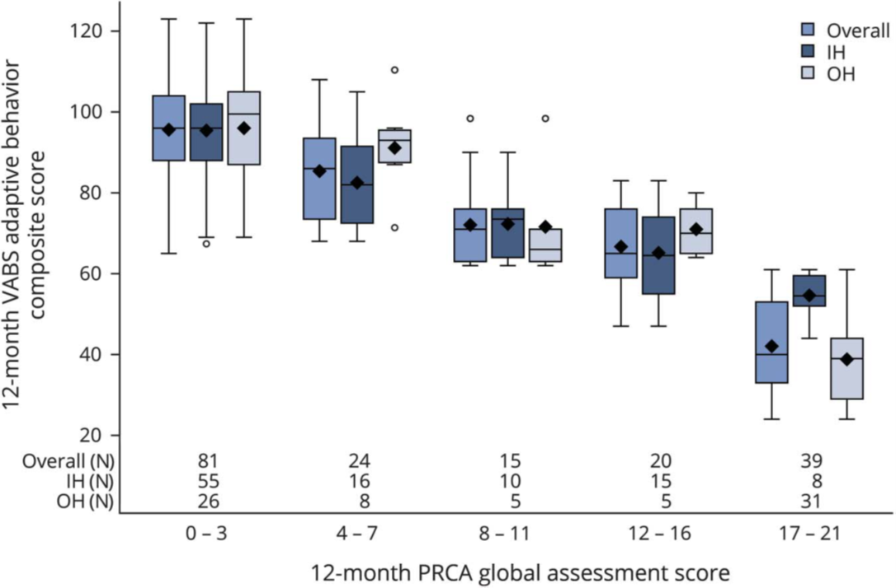
Correlation With VABS-2
Notes:
Each shaded box represents the interquartile range (middle one-half of the data), the horizontal line within the box is the median, and symbols (à)
are means; upper and lower whiskers represent
the maximum and minimum values
6

Slide 7
Normal Outcomes
16/75 OH-CA survivors had normal neurological exams one year later, including 4 who required over 20 minutes of CPR
34/104 IH-CA survivors had normal neurological exams one year later, including 13 who required over 20 minutes of CPR
Notes:
OH – 87 eligible for primary outcome, 75 examined
7

Slide 8
P-ICECAP vs. THAPCA
We anticipate that we’ll have better overall outcomes and more normal outcomes in P-ICECAP than in THAPCA-OH
Broader inclusion criteria
Inclusion of cases with motor GCS = 5
Hopefully, we’ll identify more effective treatment for some subjects

Slide 9
Outcome Assessments
WE NEED TO IDENTIFY AT LEAST ONE NEUROLOGIST AT EACH SITE WHO WILL DO THE EXAMS
WE WILL SCHEDULE ZOOM MEETINGS THIS FALL TO REVIEW P-ICECAP, EXAM PROTOCOLS, AND SCORING
Scoring forms have two versions:
Infant version – up to third birthday
Child version – age 3 and older

Slide 10
Important Task
Please identify at least one neurologist at your site by August 1 and send the name to Frank Moler (fmoler@med.umich.edu)
If you prefer, it would be fine to identify two neurologists at your site
We will have Zoom meetings in early fall to provide P-ICECAP overview and review the details of the neurological outcome evaluation plan

Slide 11
Neurological Outcome Forms
All will be reviewed by FSS or RI
Any scoring questions will be addressed with the site neurologist
Research coordinators at each site enter assessment score data in Web DCU
No information about cooling duration is included in these forms

Slide 13
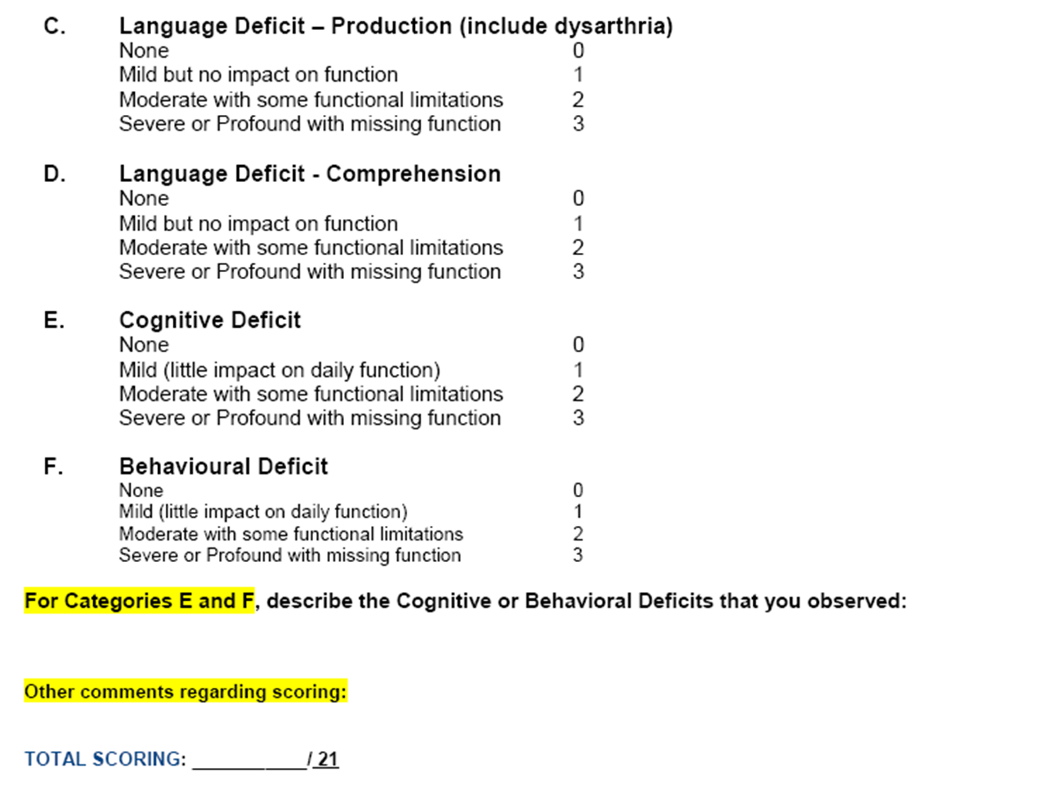

Slide 14
Questions

Slide 15
Extra Slides

Slide 16
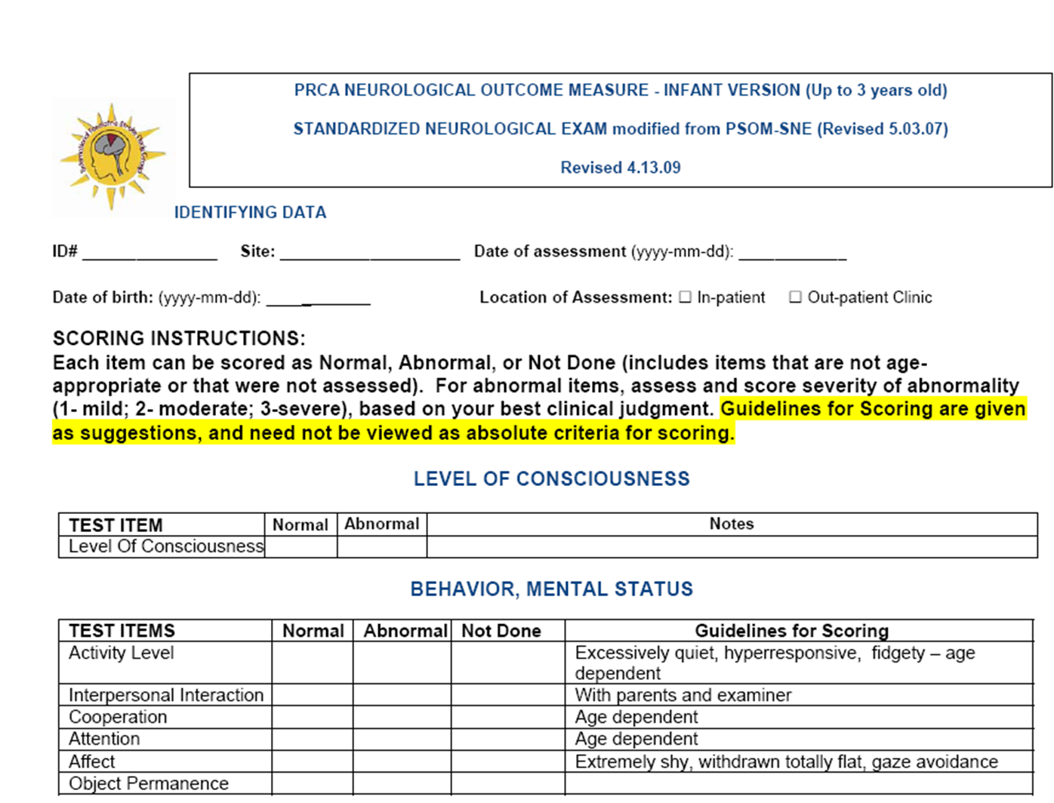

Slide 17
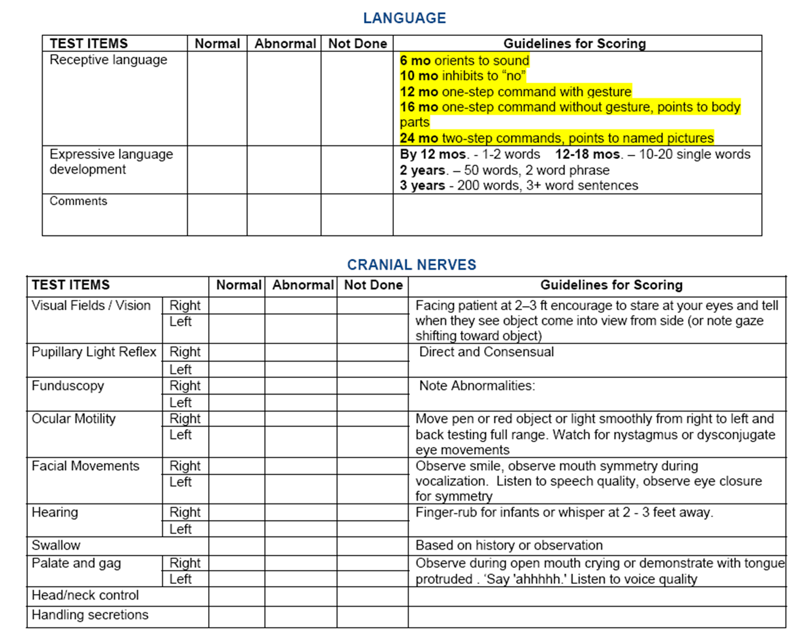

Slide 18
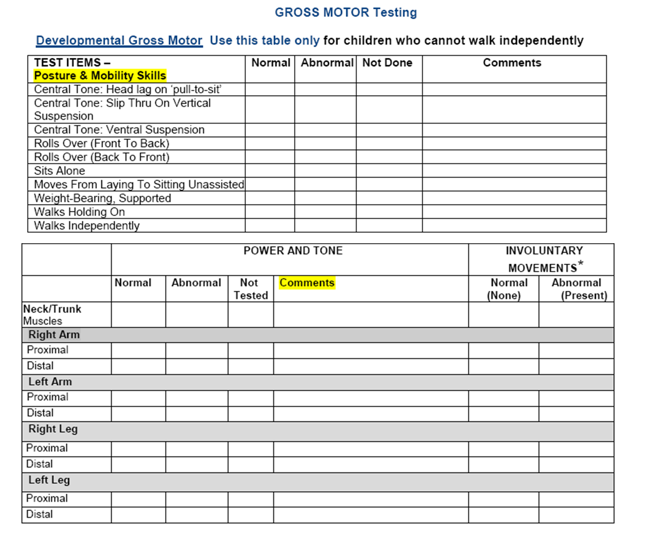

Slide 19
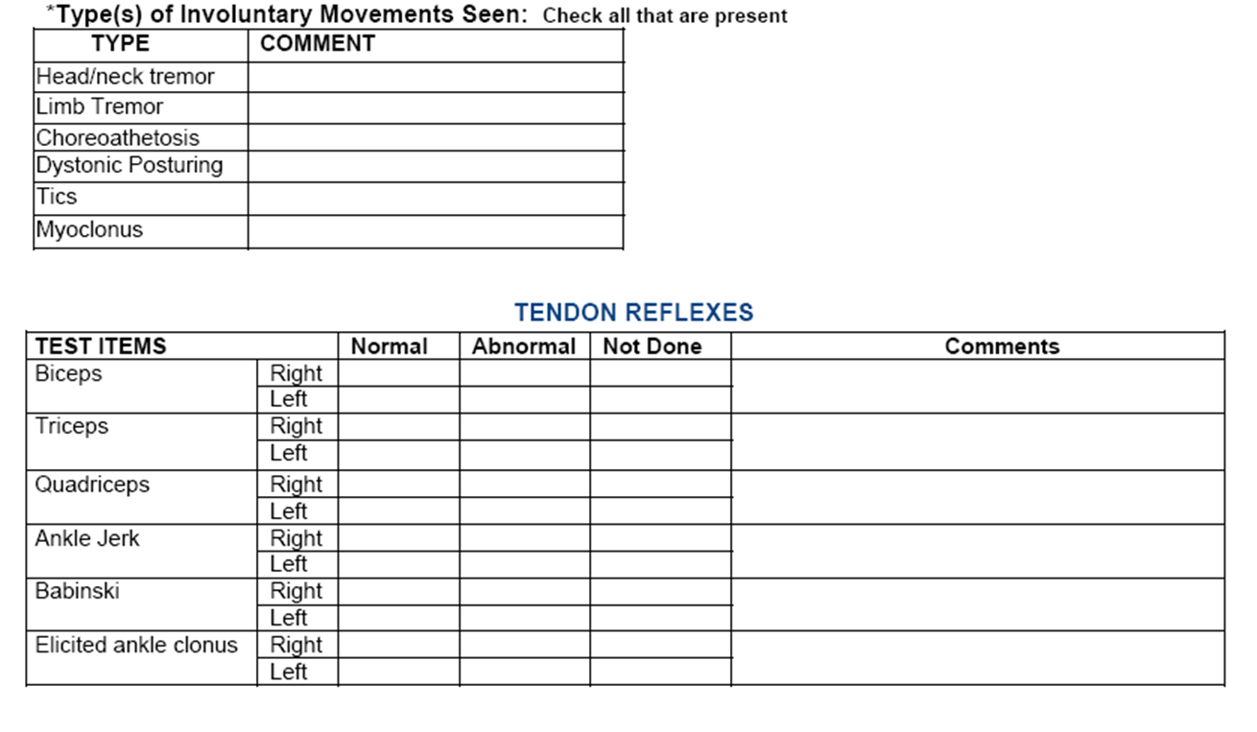

Slide 20
