Slide 1
Clinical Standardization
Dr. Alexis Topjian

Slide 2
CSG Team
Alexis Topjian, MD, MSCE - Study PI - Pediatric Critical Care
Frank Moler, MD, MS - Study PI - Pediatric Critical Care
Vinay Nadkarni, MD, MS - Co-I - Pediatric Critical Care
Faye Silverstein, MD – Co-I - Pediatric Neurology
Site PIs and Steering Committee Feedback and Input

Slide 3
Objectives
Discuss intent of clinical standardization guidelines
Review clinical standardization guidelines for P-ICECAP
Targeted Temperature Management
Post Cardiac Arrest Care
Neuroprognostication/Withdrawal
Laboratory Studies and Imaging

Slide 4
Why Clinical Standardization?
Purpose: to minimize treatment variability of participants when possible in the P-ICECAP trial in order to optimally discern the effect of the study intervention.
Goal-oriented strategy that maintains some flexibility in approach as long as a consistent target parameter is attained.

Slide 5
Why Clinical Standardization?
Made by consensus among a multidisciplinary clinical standardization team and vetting with feedback and revision among participating sites.
Most have insufficient data, however national guidelines were utilized for some elements.

Slide 6
Clinical Standardization is not…
Intended to dictate clinical practice for patients that are not enrolled in P-ICECAP
Best practice for all patients at all timepoints

Slide 7
How to implement clinical standardization
Adapt your local procedures
Create P-ICECAP order set
Educate study team and care providers
Review cases and understand there will be variability but continue education to standardize care

Slide 8
Definitions
Time of cardiac arrest:
When the child’s arrest starts (Often not known)
NOT when they are found
Time of initiation of Targeted Temperature Management
When the button on the closed loop cooling device is pushed
Eligibility criteria

Slide 9
Return of Spontaneous Circulation
ROSC is operationally defined as the restoration of a palpable pulse or a measurable blood pressure. If cardiac monitoring is available, ROSC requires an organized cardiac rhythm.
Sustained ROSC is when the patient has achieved ROSC with signs of circulation persisting for at least 20 consecutive minutes.

Slide 10
Sustained ROSC example
CPR from 2:00 to 2:10 pm
ROSC is at 2:10 pm
No additional CPR is provided for next 20 minutes
Time of sustained ROSC is 2:10pm, but you don’t know that until 2:30pm

Slide 11
Time of initiation of cooling
Time of initiation of cooling is the start of intervention
The time the device is set to a temperature between 32-34℃
After randomization, set to 33℃ should be within 15 minutes of randomization
If prior to randomization, time of button push to a temp of 32-34℃

Slide 14
Temperature Management

Slide 15
Temperature Monitoring
Continuous from time of clinical initiation through end of intervention
Core body temperature should be monitored at two core sites
Esophageal, bladder, rectal
The esophageal probe is the preferred primary probe which will be connected to the surface cooling unit.

Slide 17
Temperature Management
Clinically used servo-regulated device
Rarely ECMO
No intravascular cooling, gastric cooling etc
Can use acetaminophen as an adjunct

Slide 18
Induction of Hypothermia

Slide 19
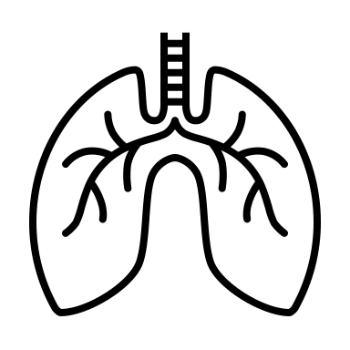
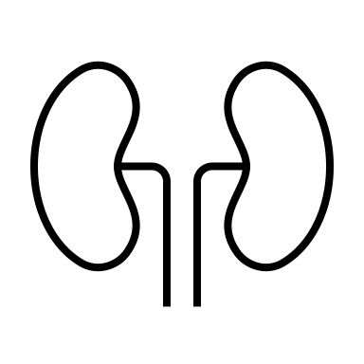
Induction Phase-Decrease in temperature to 33C
Cardiac:
↓ Heart Rate
↑ Systemic vascular resistance
↓ Cardiac output
EKG: mildly prolonged PR, wide QRS, increased QT
Endocrine/Metabolic
Hyperglycemia 🡪 diuresis
↑ insulin resistance
Target Euglycemia
Insulin infusion
Expect bradycardia
Expect cool extremities
and poor cap refill
Renal:
“Cold diuresis”
↑ venous return, ↑ ANP,
↓ ADH, tubular dysfunction
Electrolyte abnormalities
↓ K
↓ Phos
↓ Mg
Neuromuscular:
Shivering
↑ metabolic demand
Resolves < 34C
Sedate/paralyze
Monitor and replete electrolytes
Replete Fluids
Coagulation:
Mild coagulopathy
Mild ↓ platelet count and function
Other:
Altered drug metabolism
Altered blood gas analysis
Mild increase in amylase, AST/ALT
↑ fat metabolism 🡪 ↑ ketones and lactate 🡪 ↓ pH
Notes:
Mitigate some of the risks by rapid induction of hypothermia and getting to the maintenance phase quickly
Shivering – increases metabolic demand – can treat with sedatives, resolves under 34C
Decreas insulin sensitivity and decrease insulin amount secreted by pancreas
Hypothermia induced intracellular shift and tubular dysfunction (increased renal excretion of electrolytes) – depletion of magnesium, potassium, and phosphate during cooling --> risk of arrythmias
Cardiac output
Mild hypothermia in euvolemic patient will decrease HR and increase myocardial contractility – systolic function improves but mild degree of diastolic dysfunction may occur. BP usually stable or increases slightly. CO decreases (with HR) but so does metabolic demand (usually meets or exceeds decrease)
DEEP hypothermia: decreases myocardial contractility, risk of arrhythmia and less likely to have successful treatment of arrhythmia (hypothermic myocardium less responsive to antiarrhytjmics and more difficult to defibrillate)
Does her underlying HOCM play into your management at all? If so, how?
Likes to be full…
Hypovolemia (cold diuresis) – increased venous return (peripheral vasoconstriction), activation of atrial natriuretic peptide, decreased ADH and renal ADH receptor levels, and tubular dysfunction
EKG changes: initially sinus tachycardia followed by sinus bradycardia – can also see prolonged PR, increased QT interval, some widening of the QRS
Coagulopathy:
Metabolic rate decreases 50-65% -- decreased O2 consumption and CO2 production
Decreased O2 consumption means theoretical risk during reperfusion because high O2 may increase reperfusion injury
Decreased CO2 production may result in hyperventilation if vent not changed (and therefore cerebral vasoconstriction)
Decreased calorie needs; increased fat metabolism leading to increased glycerol, free fatty acids, ketonic acids, and lactate – can cause mild metabolic acidosis
Decreased insulin secretion (and many patients a moderate and sometimes severe insulin resistance) – important to remember during rewarming
Decreases coagulation activation and formation of microthrombi
Improves tolerance for ischemia
Suppress epileptic activity
At what point do you care about HR?

Slide 20
Rewarming Phase
Rewarm slowly over 16 hours to 36.8
Cardiac:
↓ Systemic Vascular Resistance
Vasodilation
Hypotension
Tachycardia
Neuromuscular:
Shivering
↑ metabolic demand
Resolves < 34C
Sedate/paralyze
Replete fluids
Start vasopressors
Renal:
Electrolyte abnormalities
↑ K due to cellular shifts, stopping insulin,
Decreased urine output, and exogenous repletion
Other:
Altered drug metabolism
Altered blood gas analysis
Monitor Potassium closely
Remove potassium from fluids
Treat hyperkalemia

Slide 21
Vascular Access
Central Venous Catheters
PICC line
Temporary CVC
Broviac
Arterial Line
(place ASAP , much harder when cold)

Slide 22
Sedation and Analgesia
Goal: Sedation scores are per your ICU with a target of “sluggish or no response to noxious stimulus.” (e.g. SBS -2, RASS -4)
Decisions regarding agents are at the jurisdiction of the clinical team with the following guidance

Slide 23
Sedation and Analgesia
Should be initiated as a continuous infusion with intermittent boluses to achieve goal sedation score.
Titrate to achieve sedation score
After rewarming is complete sedation goals are at the jurisdiction of the clinical team

Slide 24
Sedation and Analgesia
Goal: “sluggish or no response to noxious stimulus.”
Common sedatives: dexmedtomidine and midazolam
Common analgesics: narcotics
If after the first 4 hours of intervention the patient has no clinical response to noxious stimulus sedative and analgesics can be weaned
May wean off after 24 h if no response to noxious stimulus.

Slide 25
Shivering
Occurs during induction and rewarming when above 34 C
Shivering will slow cooling to a goal temperature.
Makes it more difficult to maintain target temperature
May be uncomfortable for patients
Adversely affect the patient’s metabolic needs

Slide 26
Shivering
Goal: prevent and treat shivering
May be subclinical and difficult to detect
May be difficult to differentiate from seizures or myoclonus
Sites that have shivering scores and protocols can use them
Treatments: Dexmedtomidine, Demerol, shin counterwarming, neuromuscular blockade

Slide 27
Physiological Goals and Management

Slide 28
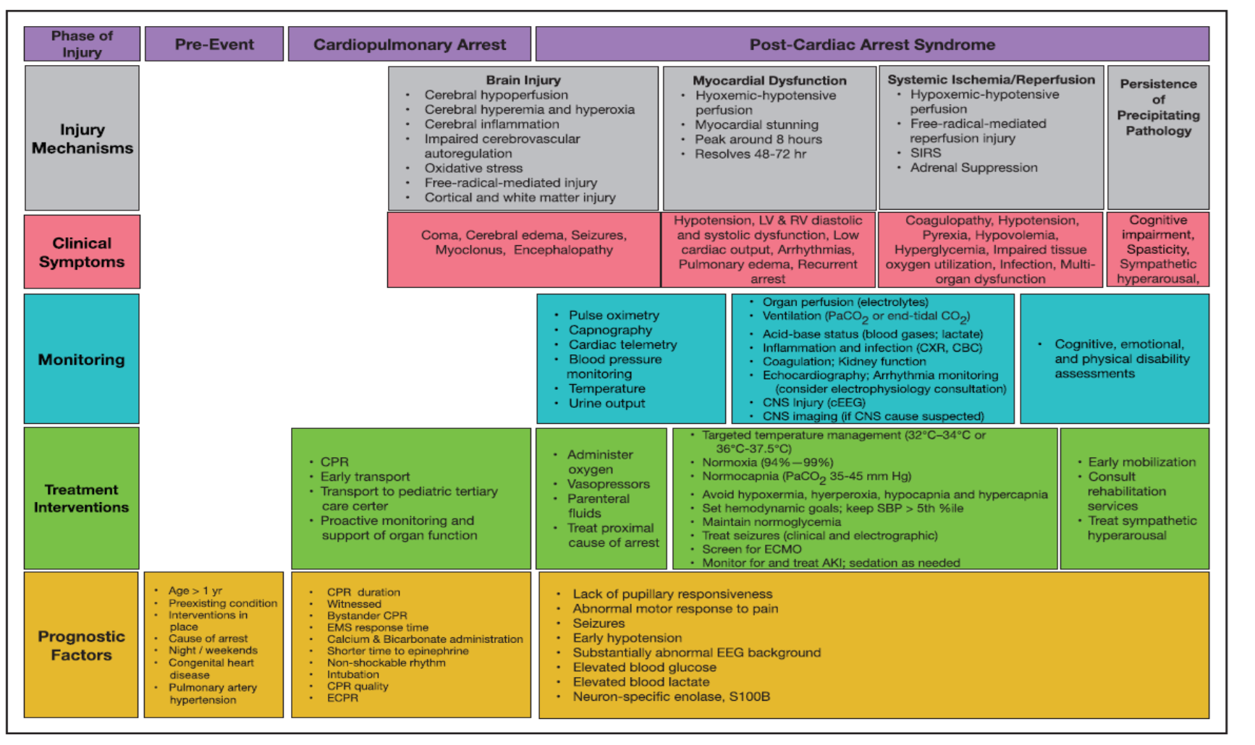

Slide 29
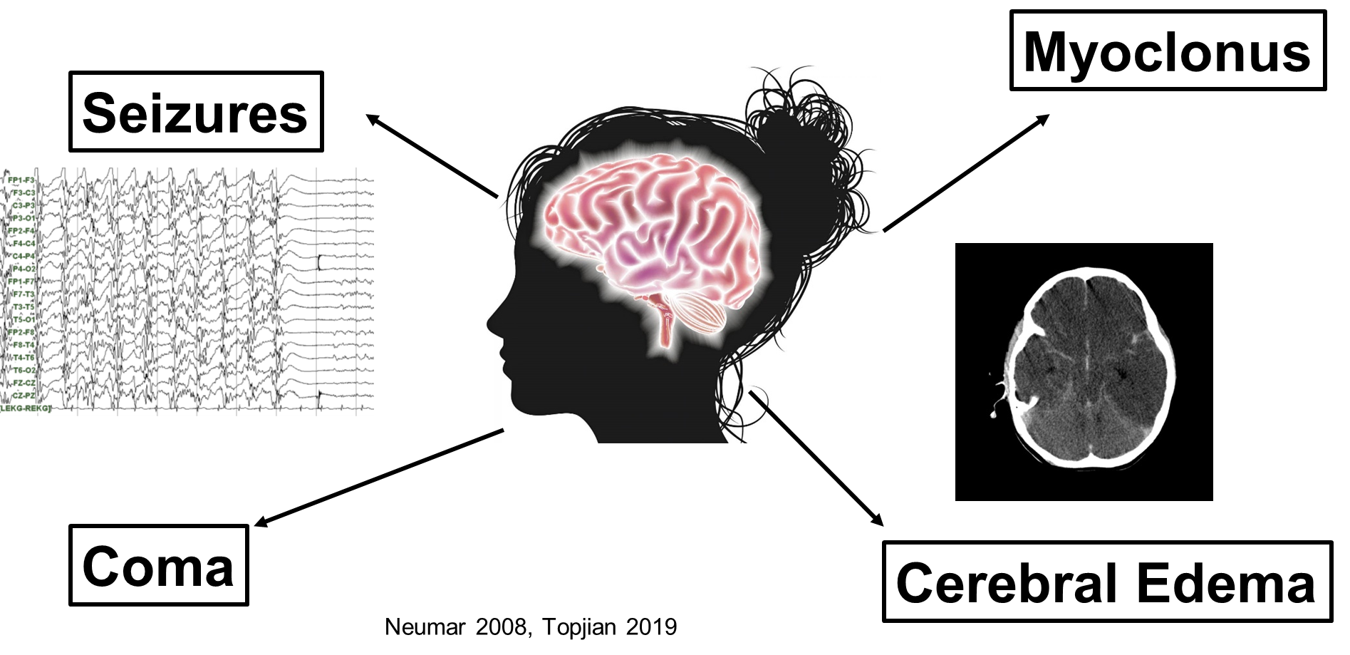
Post Arrest Brain Injury

Slide 30
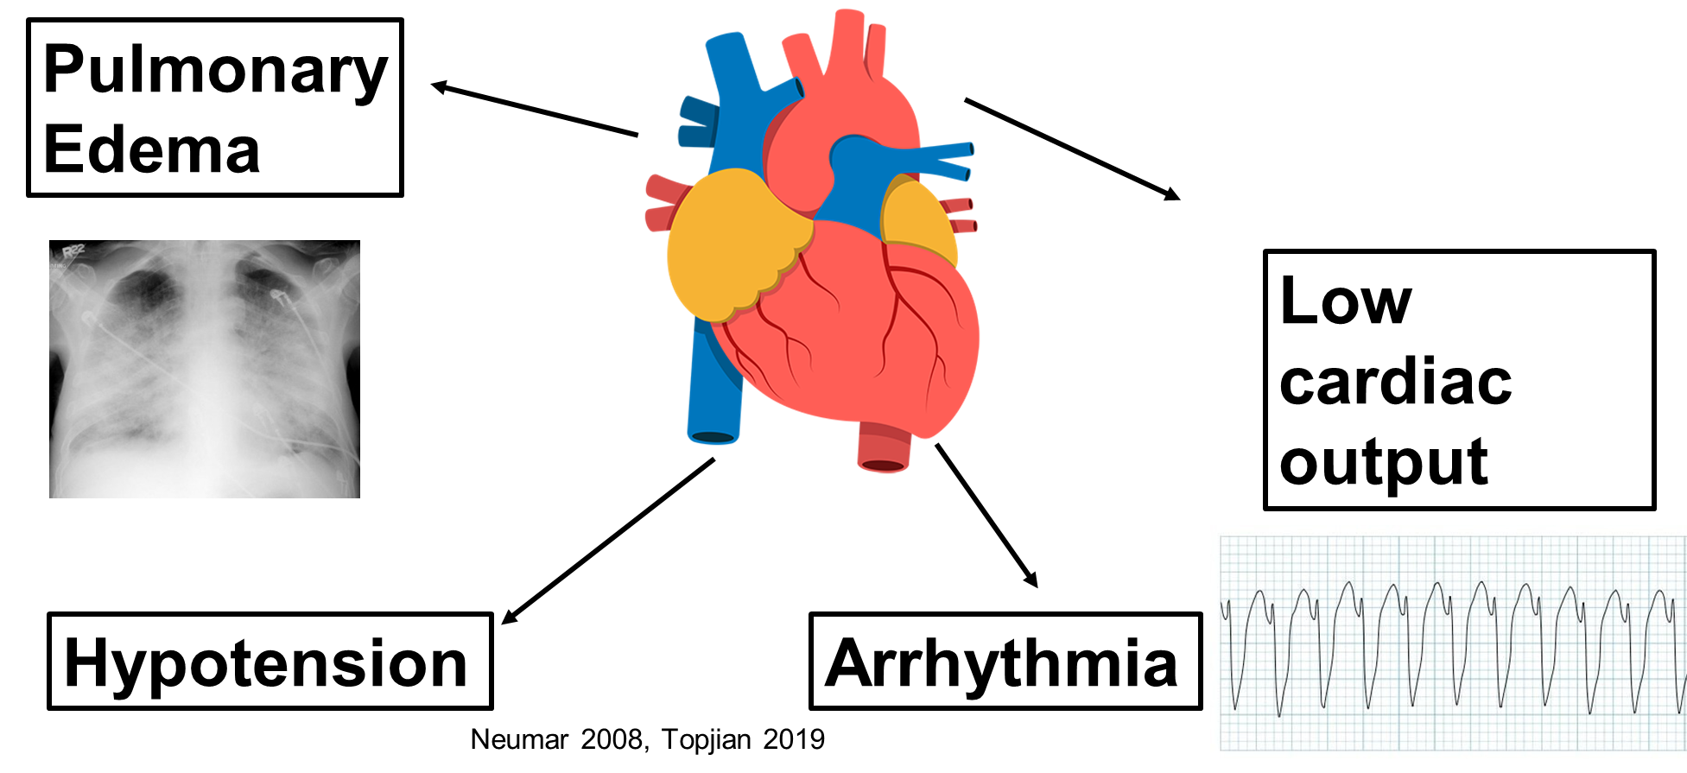
Post Arrest Myocardial Dysfunction
Notes:
A myocardial stunning that peaks around 8 hours and then resolves over 48-82 hours. Children can initially be hyperdynamic and hypertensive from the epinephrine and then have progressive hypotension

Slide 31
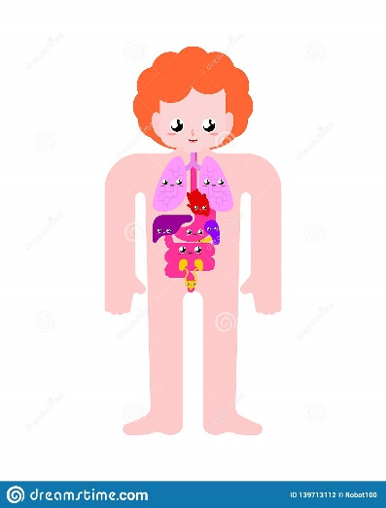
Post Arrest Systemic Ischemia/Perfusion
Pyrexia
Coagulopathy
Hyperglycemia
Adrenal Suppression
Hypovolemia
Infection
Vasoplegia
End Organ Dysfunction
Neumar 2008, Topjian 2019

Slide 32
Blood Pressure
Goal: target a blood pressure higher than at least the 25th percentile in order to avoid hypotension < 5th percentile.
Treatment: Fluids, vasopressors and inotropes at the discretion of the clinical team to meet the goal

Slide 33
AHA PALS Guidelines: Blood Pressure
After ROSC, we recommend that parenteral fluids and/or vasoactive drugs should be used to maintain a systolic blood pressure greater than fifth percentile for age
When appropriate resources are available, continuous arterial pressure monitoring is recommended
Topjian, Circulation, 2020

Slide 34
Oxygenation
Goal
For patients with expected baseline SpO2 >94%, should be maintained oxygen saturation 94 -98%
For patients with baseline lower saturations due to an underlying condition (e.g cyanotic heart disease), target saturations appropriate to the patient’s underlying condition
Treatment: Titrate FiO2, ventilator rate, volume, or peak end expiratory pressure (PEEP) at discretion of the clinical team.

Slide 35
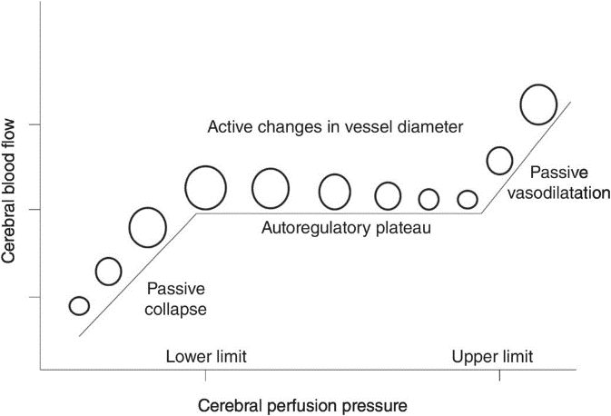
Ventilation
Goal
If pre-arrest baseline PaCO2 35-45, target normocapnia (eg.PaCO2 35–45 mm Hg), limiting exposure to severe hypercapnia and hypocapnia while accounting for appropriate pH.
If pre-arrest higher baseline PCO2 due to an underlying condition target pCO2 appropriate to the patient’s baseline PCO2, limiting exposure to relative hypercapnia and hypocapnia, while accounting for appropriate pH.
Treatment: at the discretion of the clinical team.

Slide 36
Euglycemia
Goal: Serum glucose is between 80 to 200 mg/dL, prevent hypoglycemia
Treatment
Administering glucose containing fluids and titrating insulin or removing dextrose from fluids.
Be aware: On rewarming, insulin resistance lessons and hypoglycemia may develop rapidly.
Insulin can cause hypokalemia, closely monitor during induction to replete and during rewarming remove potassium if insulin stopped

Slide 37
Seizure Monitoring
Seizures are common after cardiac arrest.
When resources are available, continuous electroencephalography (EEG) monitoring is recommended for the detection of seizures and evaluation of treatment efficacy (AHA 1, LOE C-LD)
If continuous EEG is not available, intermittent screening EEG can be used.
Duration of monitoring at the discretion of the clinical team.

Slide 38
Seizure Treatment
Treatment is recommended for clinical and electrographic seizures (AHA 1 , LOE C-LD).
Treatment of electrographic status epilepticus should optimally occur in conjunction with neurologists (AHA 2a, LOE C-EO).
Selection of anti-seizure medication(s) is at the discretion of the attending physician(s).
Side effects of antiseizure medication should be considered.

Slide 39
Monitoring and Assessments

Slide 40
Laboratory testing will be conducted at baseline and throughout the intervention period (0 to 120 hours).
Basic metabolic panel, glucose, calcium, mag, phos for safety
Q6 hours during induction and rewarming
Q12 during maintenance hypothermia and normothermia periods:

Slide 41
Daily
Complete blood count (CBC),
Liver function tests (LFTs)
Daily coagulation profile: prothrombin time (PT) and International Normalized Ratio (INR), partial thromboplastin time (PTT),
Arterial Blood Gas At least, daily for the first 72 hours.

Slide 42
Cultures & Imaging
Blood cultures
Randomization, days 2 and 4
Baseline respiratory culture
Chest xray
Daily to confirm esophageal probe location

Slide 43
Post-Arrest Care Continuum
Post-Cardiac Arrest Care
Stratification & Neuroprognostication
Identify and stratify injury severity
Assess end organs
Titrate therapies
Prepare families
Withdraw life sustaining therapy
Enhance recovery/rehab

Slide 44
Withdrawal from intensive care and life support
Patients are ineligible for this study if an early withdrawal of life support (prior to 120 hours) is consistent with goals of care

Slide 45
Withdrawal of life sustaining therapies prior to 120 hours after randomization
After cooling and rewarming and sedatives are off for an appropriate period of time.
Brain Death Evaluation
Consistent with institutional brain death pathway
Patients should be rewarmed and off sedation and paralytics >24 hours
In individuals who have undergone cooling for more than 24 hours a longer time interval prior to initiation of a brain death evaluation should be considered.

Slide 46
Withdrawal of life sustaining therapies prior to 120 hours after randomization
Neurologic Futility:
In select cases (eg. herniation on neuroimaging, or > 24 h fixed non-reactive pupillary responses, with absent motor responses to painful stimuli in the absence of paralytics or sedation).
Consultation with neurology and documentation of criteria upon which the decision to withdraw life-sustaining therapies should be considered in this setting.

Slide 47
Withdrawal of life sustaining therapies prior to 120 hours after randomization
Non-neurological Prognosis: Life support may be withdrawn prior to 120 hours for futility or otherwise poor prognosis based on non-neurological problems
Changes in Goals of Care: Changes in goals of care are not to be pursued with the parent or LAR prior to 120 hour from randomization.

Slide 48
Withdrawal of life sustaining therapies after 120 hours from randomization
Determination of neurologic prognosis: If the clinical team feels that the neurologic prognosis is most consistent with irreversible injury such that a favorable outcome is no longer possible, they may undertake testing for neurologic prognostication. Neurologic prognostication of unfavorable outcome is a common basis for withdrawal of life sustaining therapies that invariably leads to death.

Slide 49
Approach to surgical procedures or imaging
For brief imaging (eg. head CT) closely monitor temperature during transport; temperature may drop below intended range.
More prolonged imaging is unlikely to be performed as neuroprognostication will not occur until after 120 hours.
If procedures or surgeries are clinically necessary during the cooling intervention, clinicians and proceduralists should consider the impact of cooling (eg. bleeding risk) on the participant and determine if rewarming is necessary based on what is best for the patient.

Slide 50
Tracking and Reporting of Clinical Guideline Variations and Excursions
There will be tracking of excursions and feedback to sites for improvement
More to come…

Slide 51
Order Set Creation
Create and order set
Can share through epic via userweb

Slide 52
Summary
Standardized post cardiac arrest care will minimize the risk of losing the true signal of the study
Work and educate your clinical team

