Slide 1
Adaptive Design
Dr. John VanBuren

Slide 2
Outcome
Primary outcome: 12-month VABS-3 Mortality Composite Score
Death at 12 months is scored a 0
VABS-3 score is used among survivors
The 3-month VABS-3 Mortality Composite Score used in longitudinal modeling when no 12-month score available

Slide 3
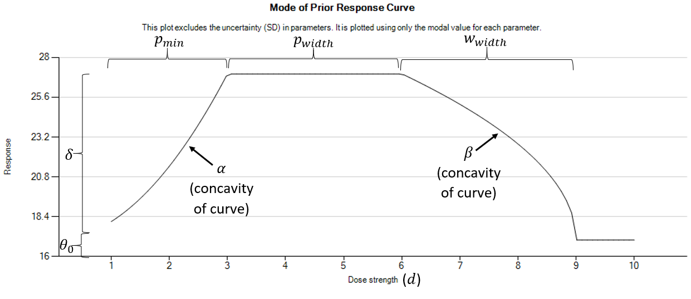
Dose Response Model
Optimal Dose:
The start of the plateau/peak

Slide 4
Interim Looks and Allocations
First 150 subjects allocated equally to 24, 48, and 72 hours
After 150 total enrolled, interims every 10 weeks
Allocation proportions are the probability each cooling duration is optimal dose

Slide 5
Example Trial

Slide 6
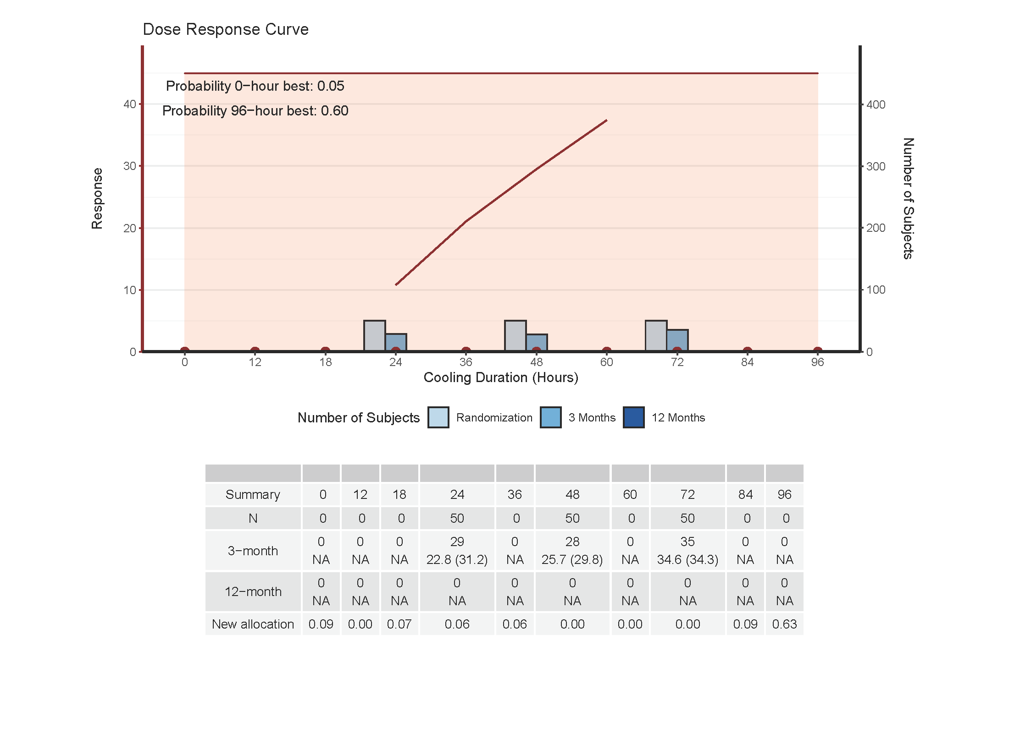

Slide 7
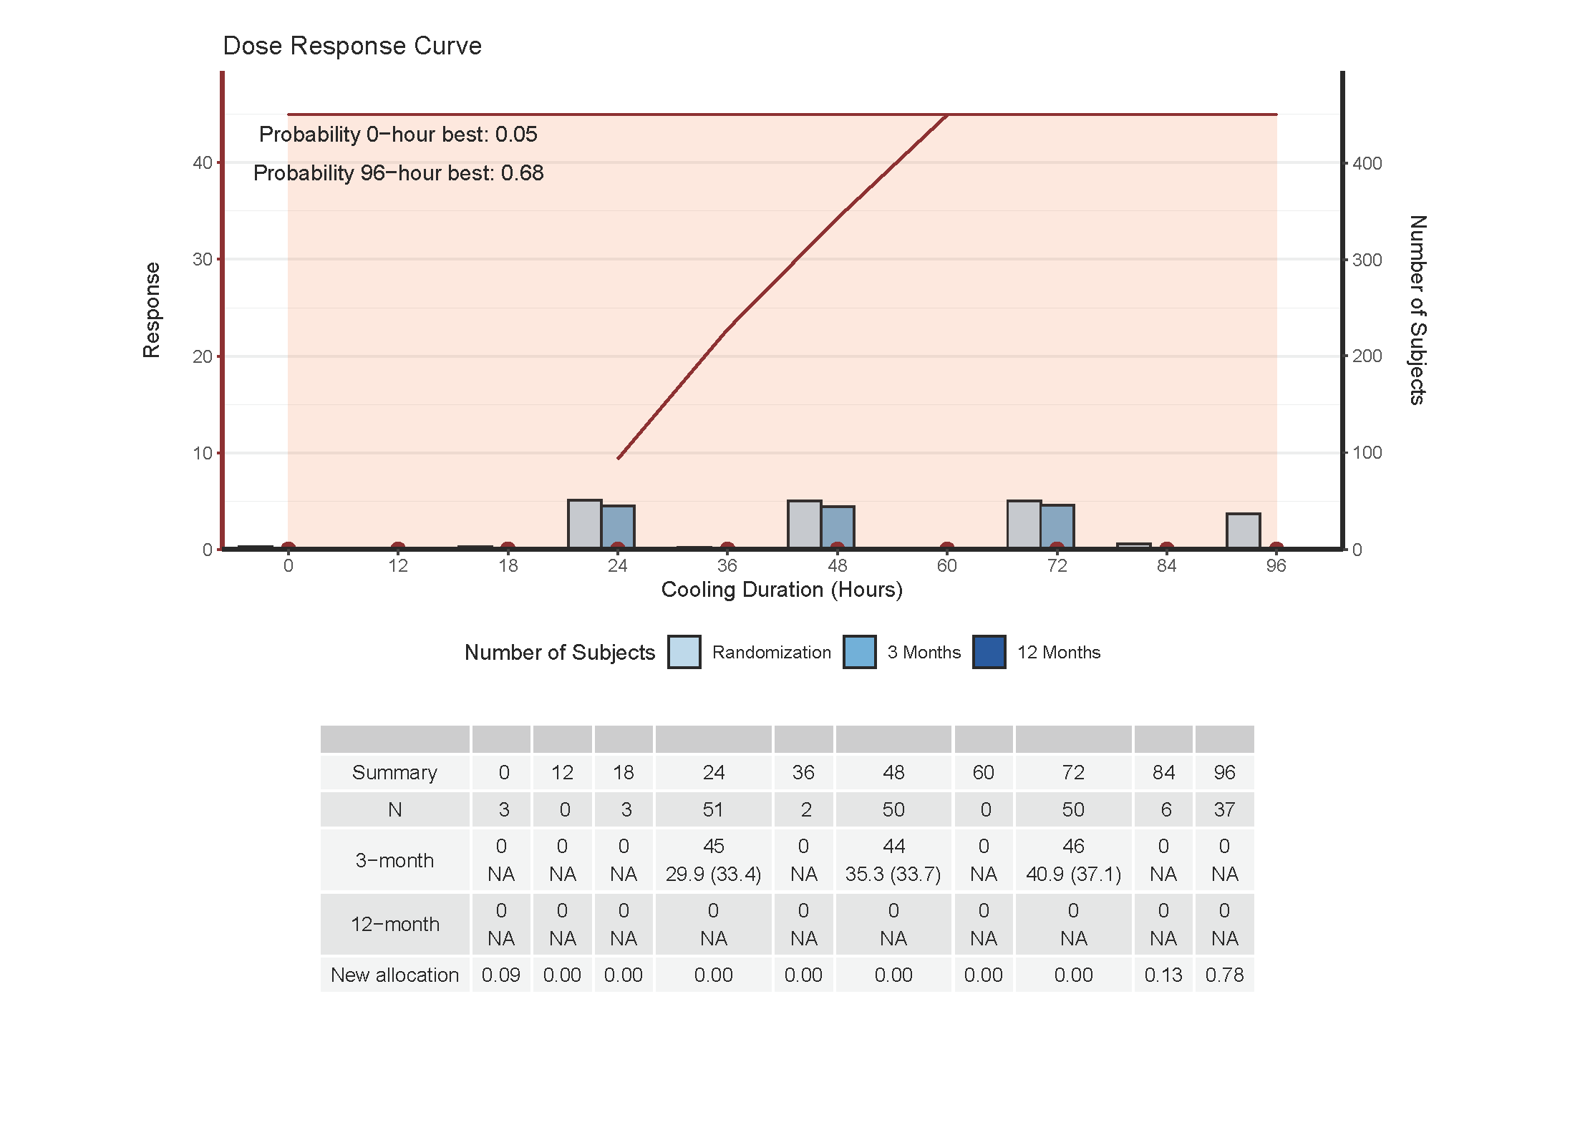

Slide 8
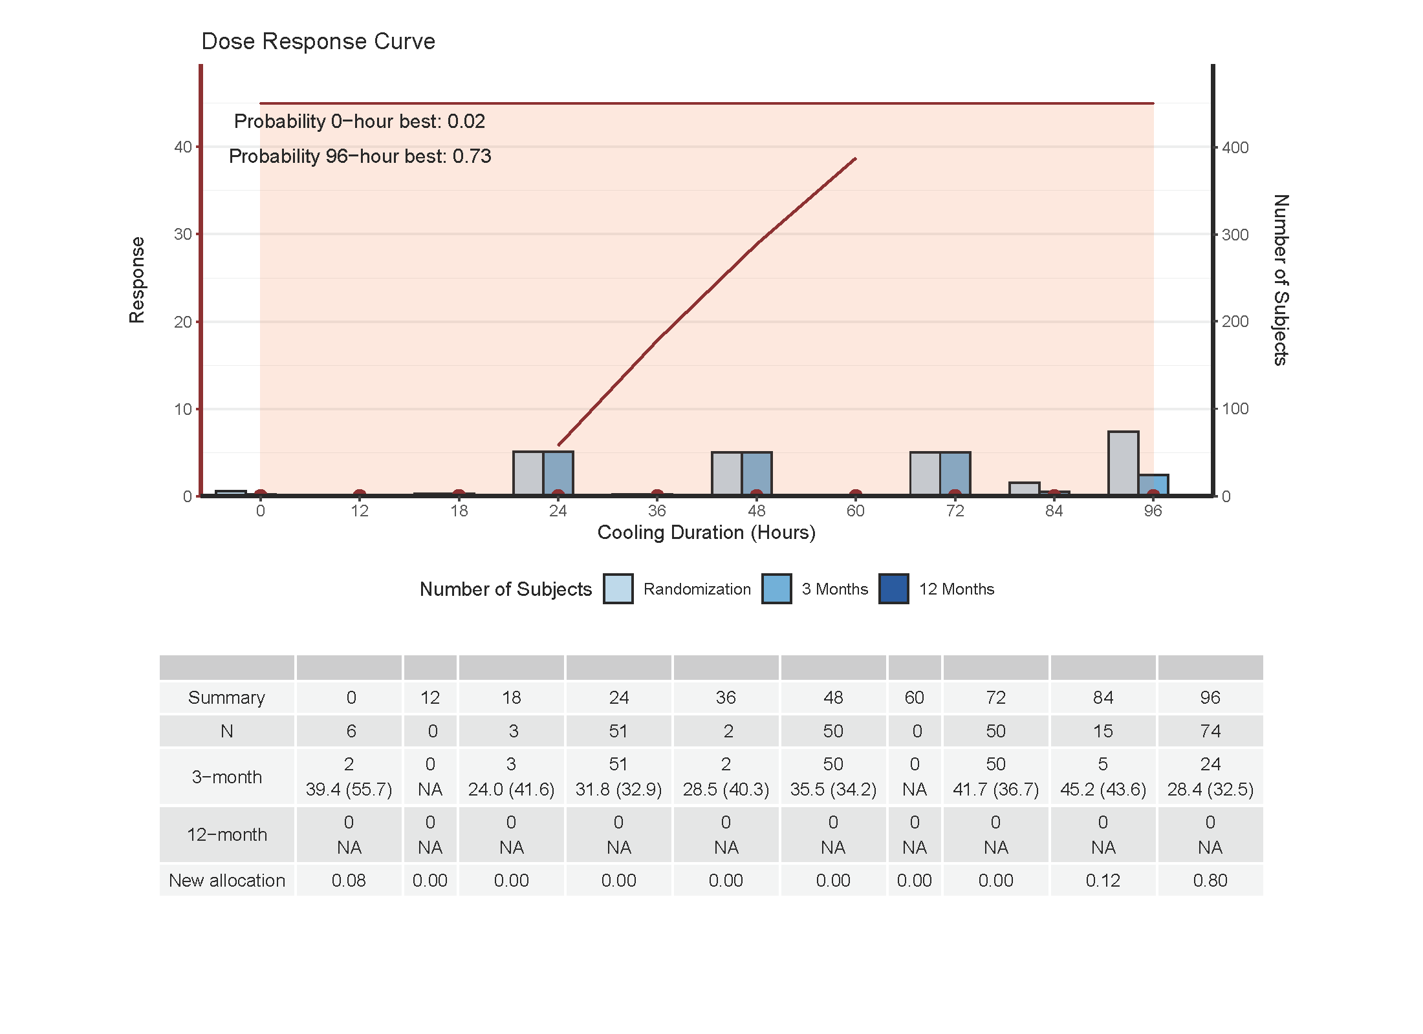

Slide 9
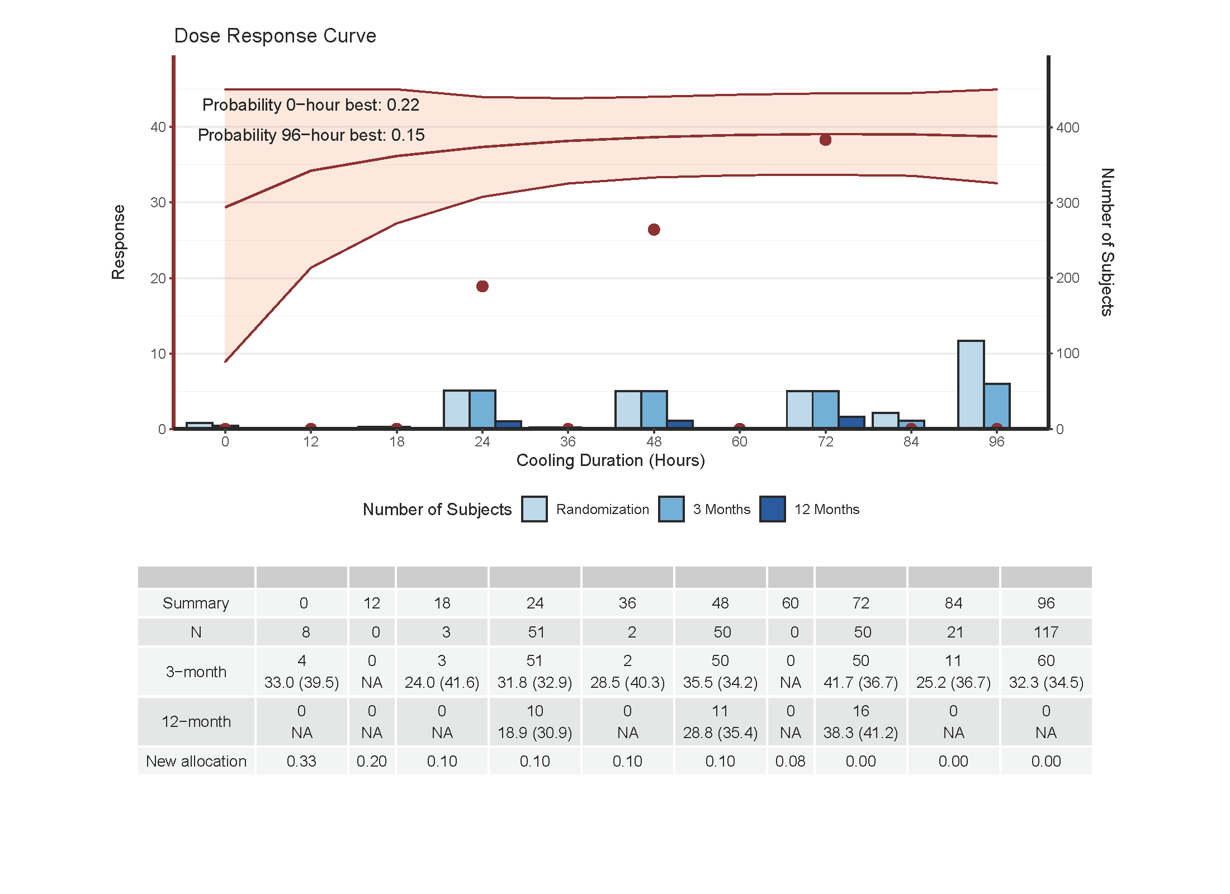

Slide 10
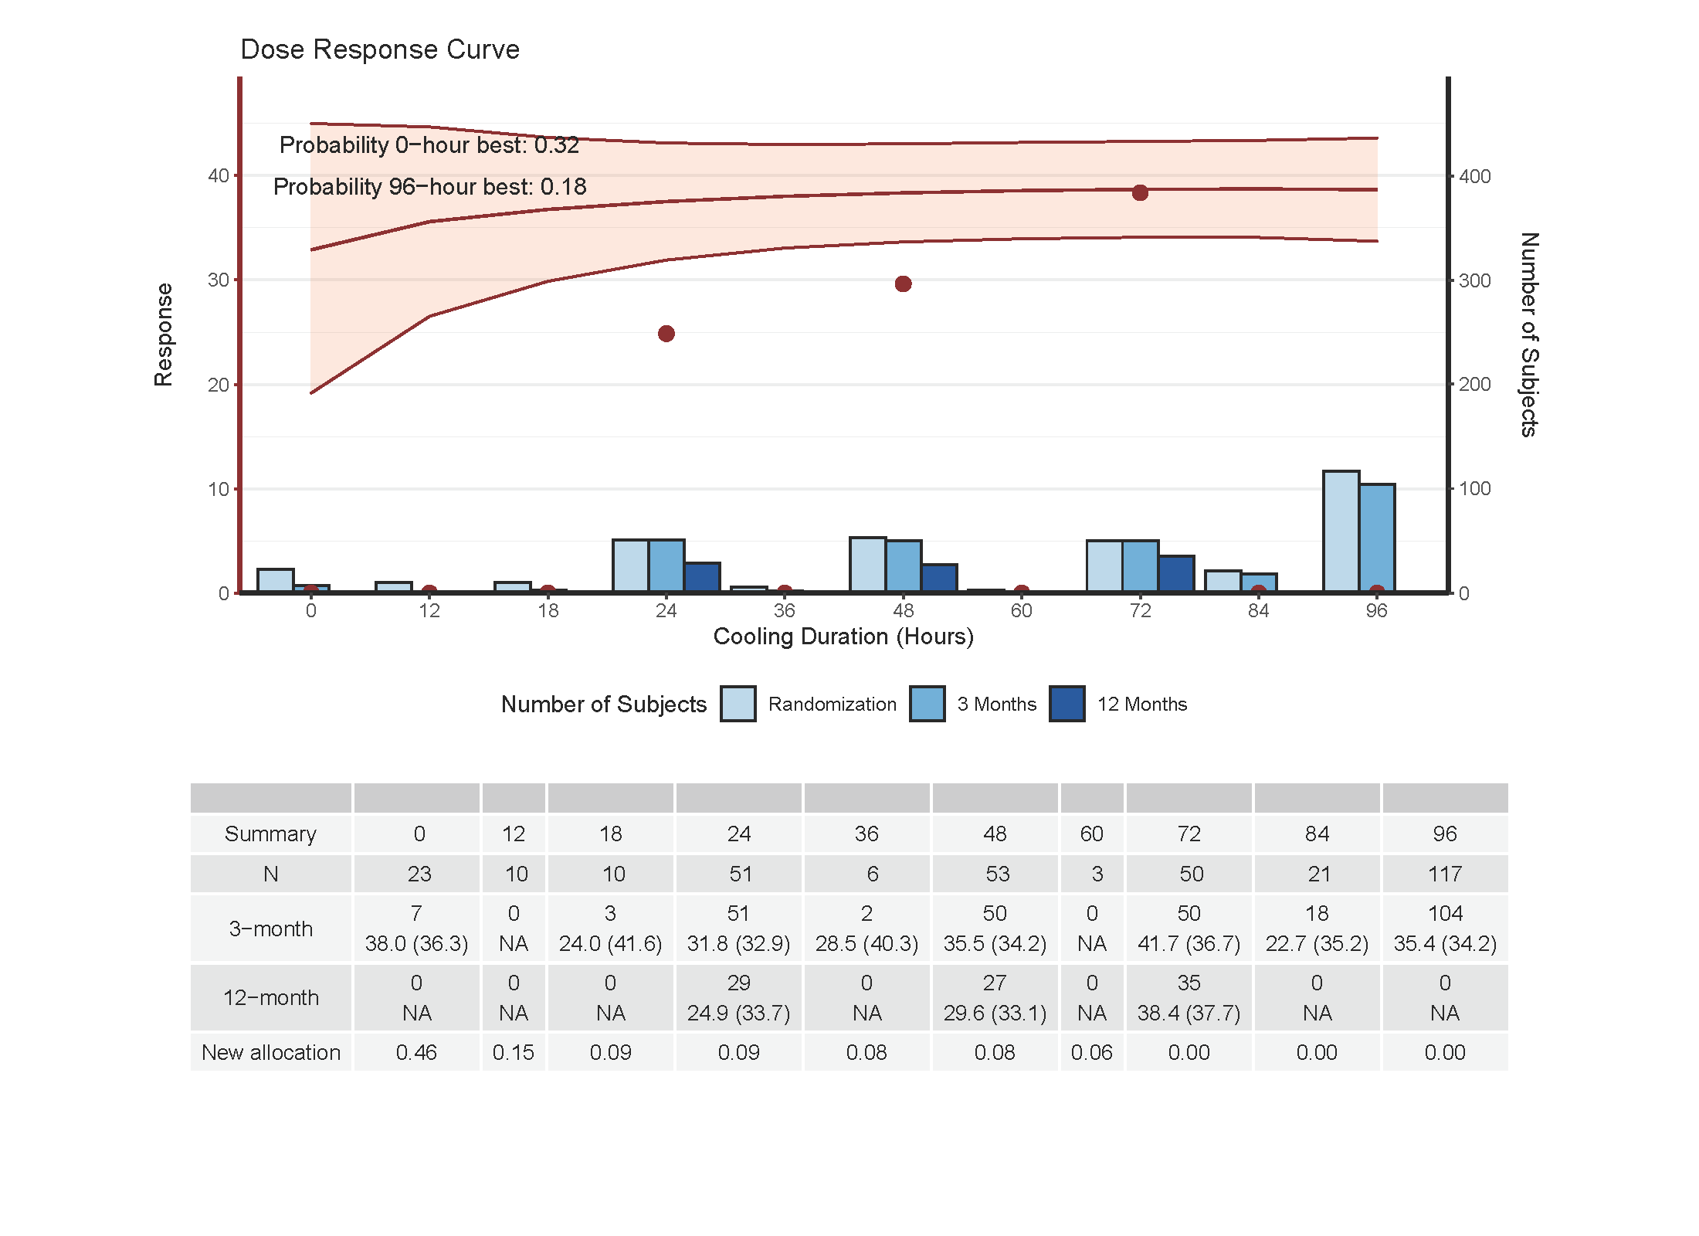

Slide 11
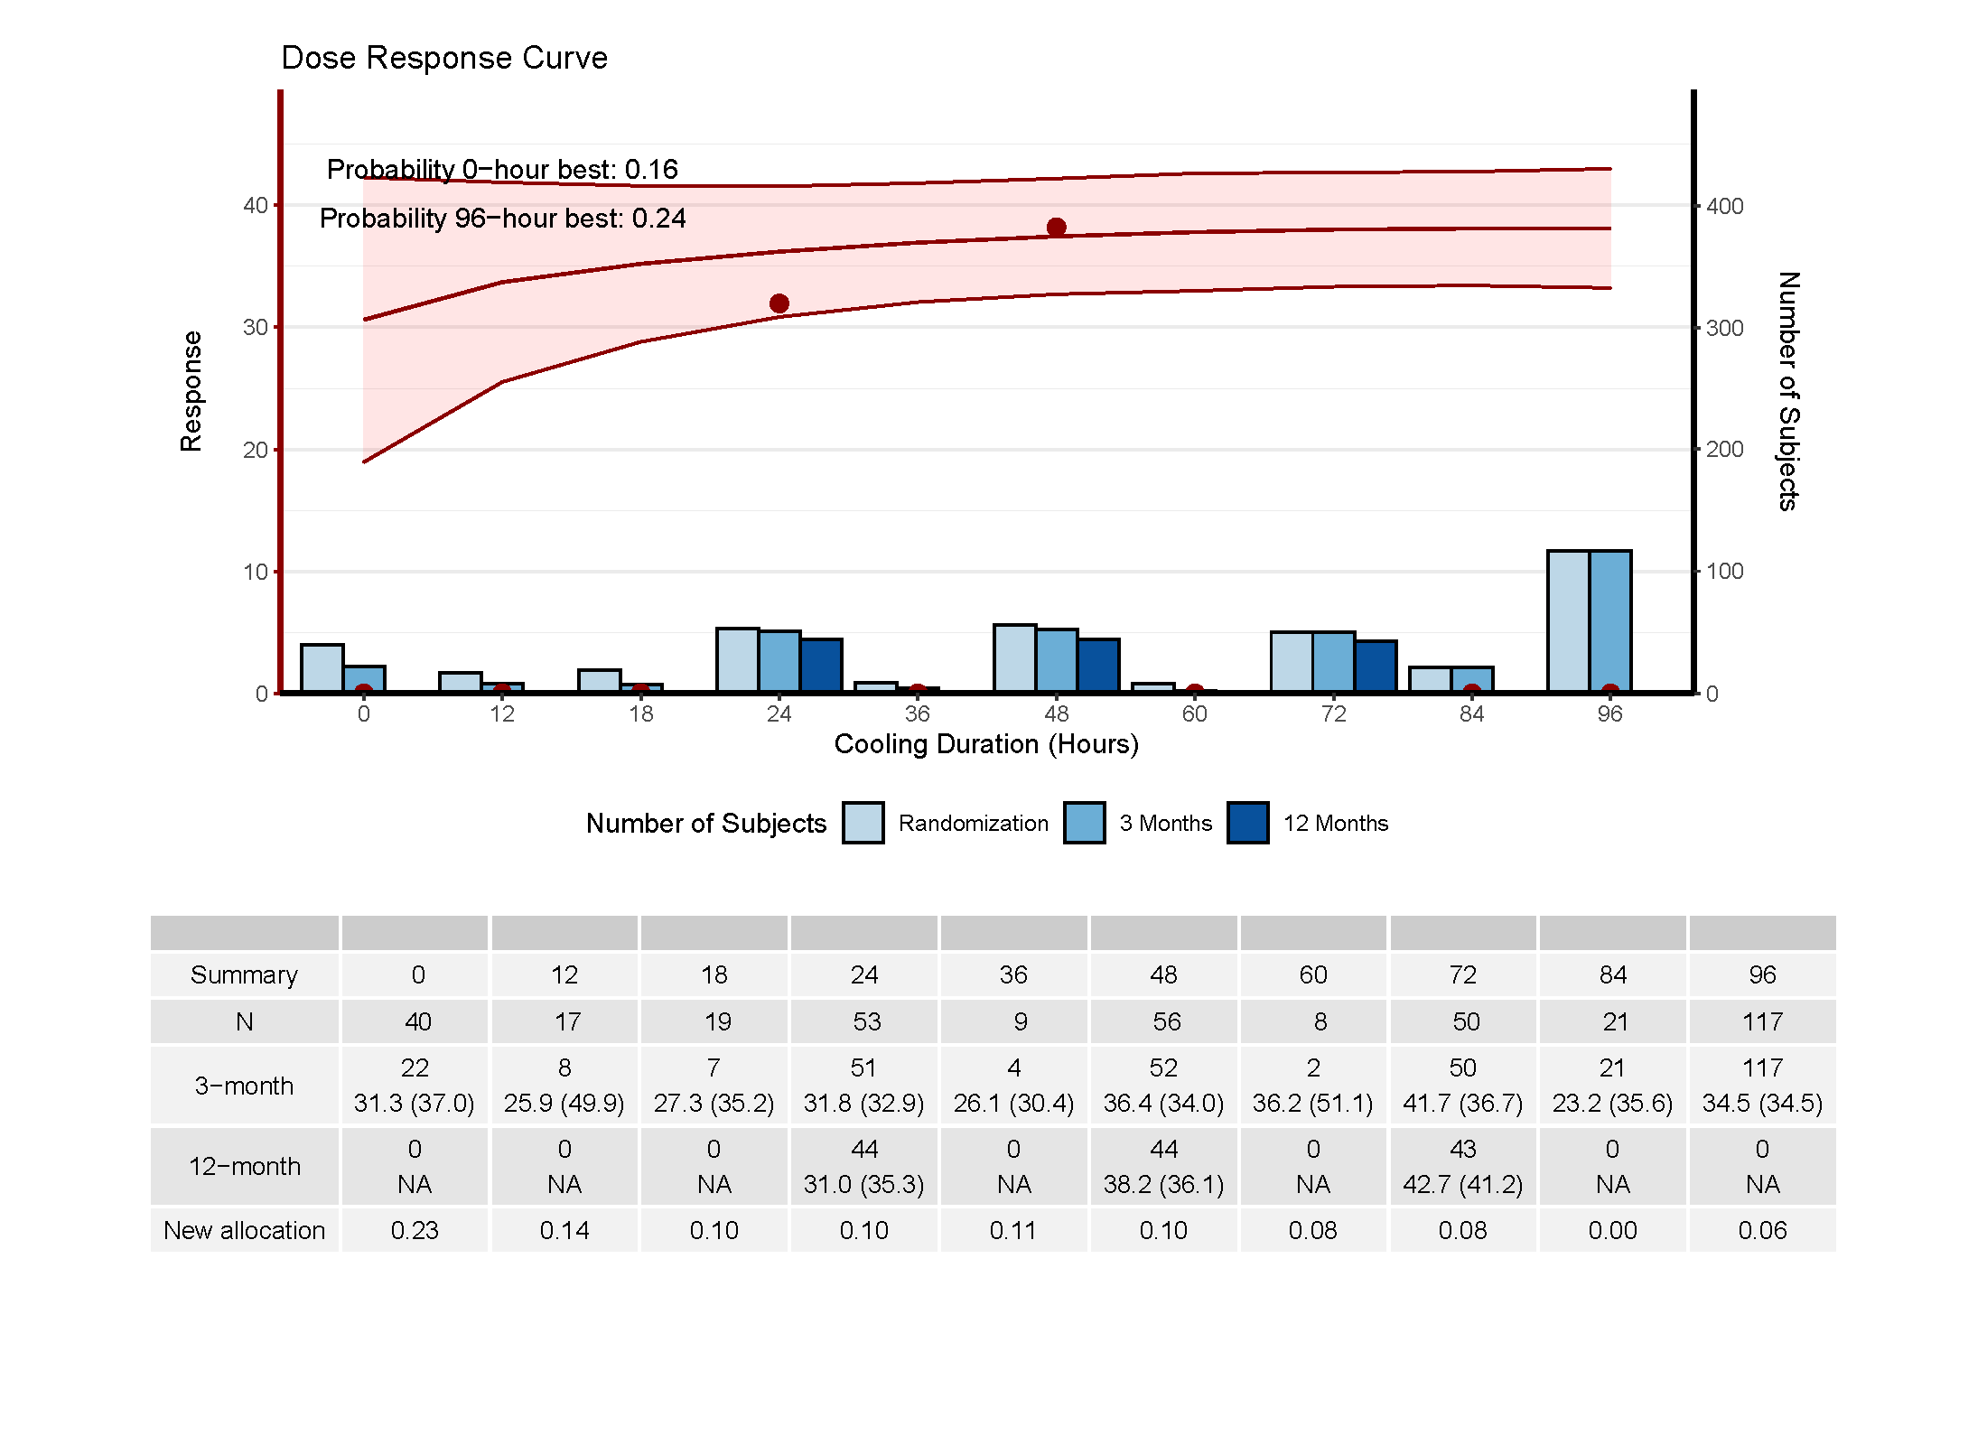

Slide 12
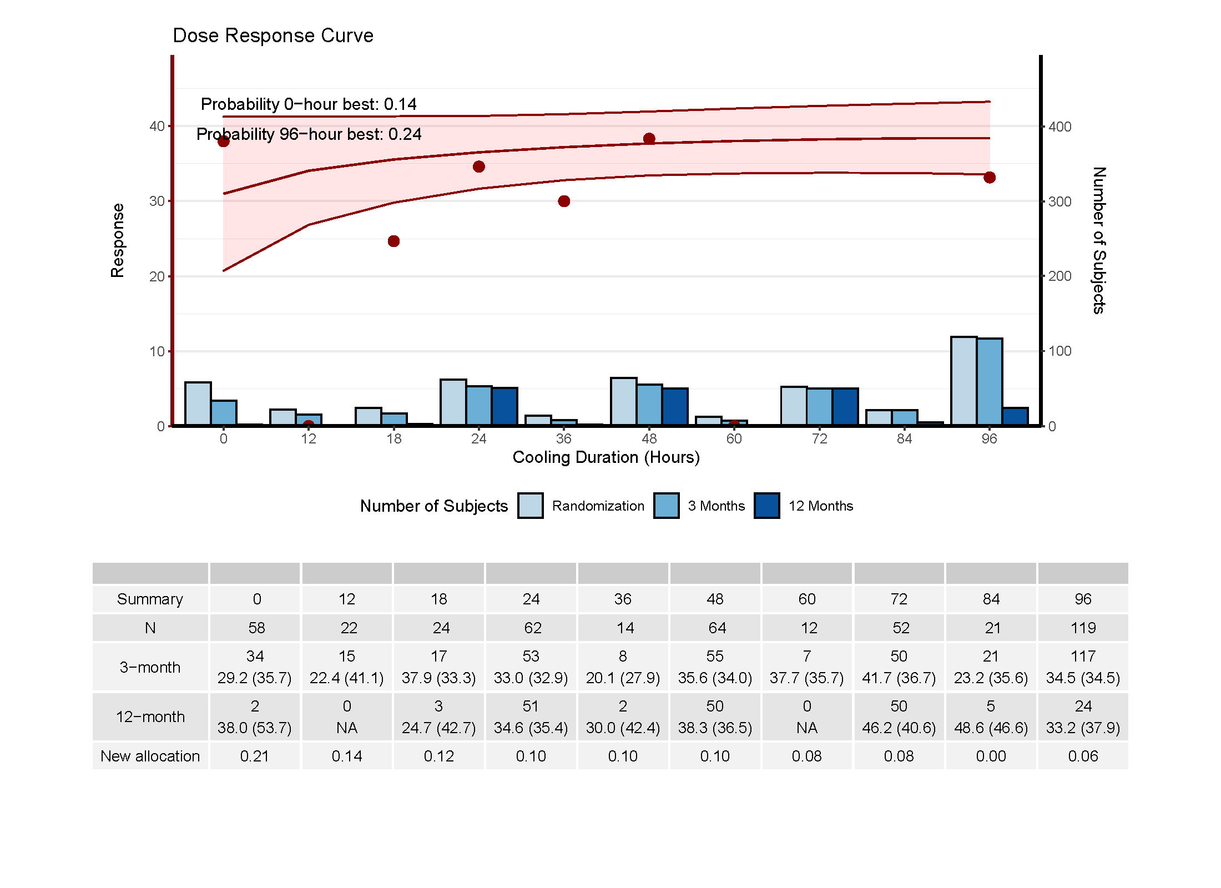

Slide 13
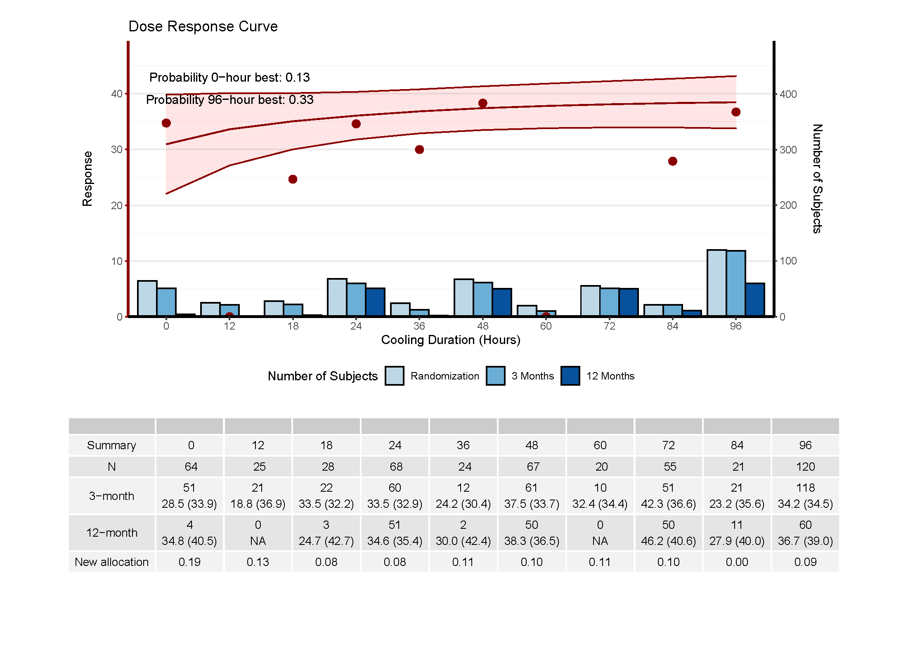

Slide 14
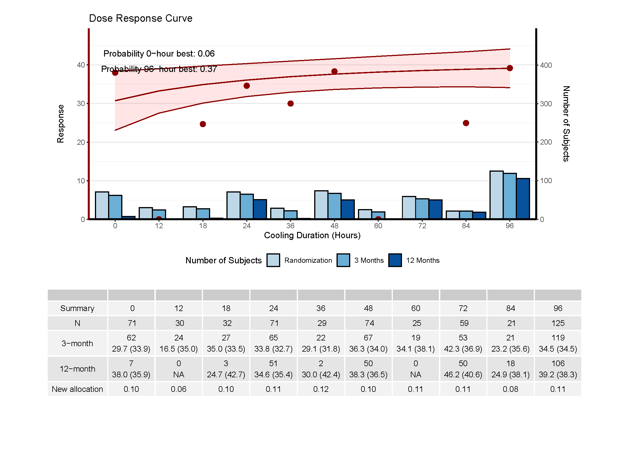

Slide 15
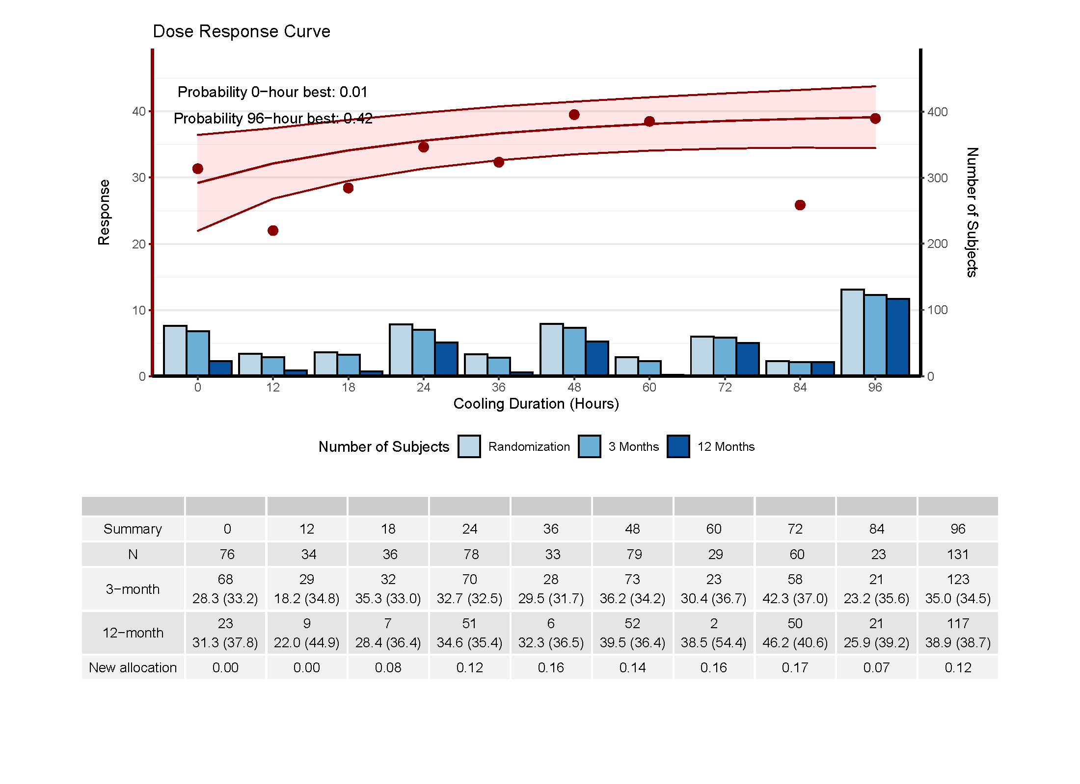

Slide 17
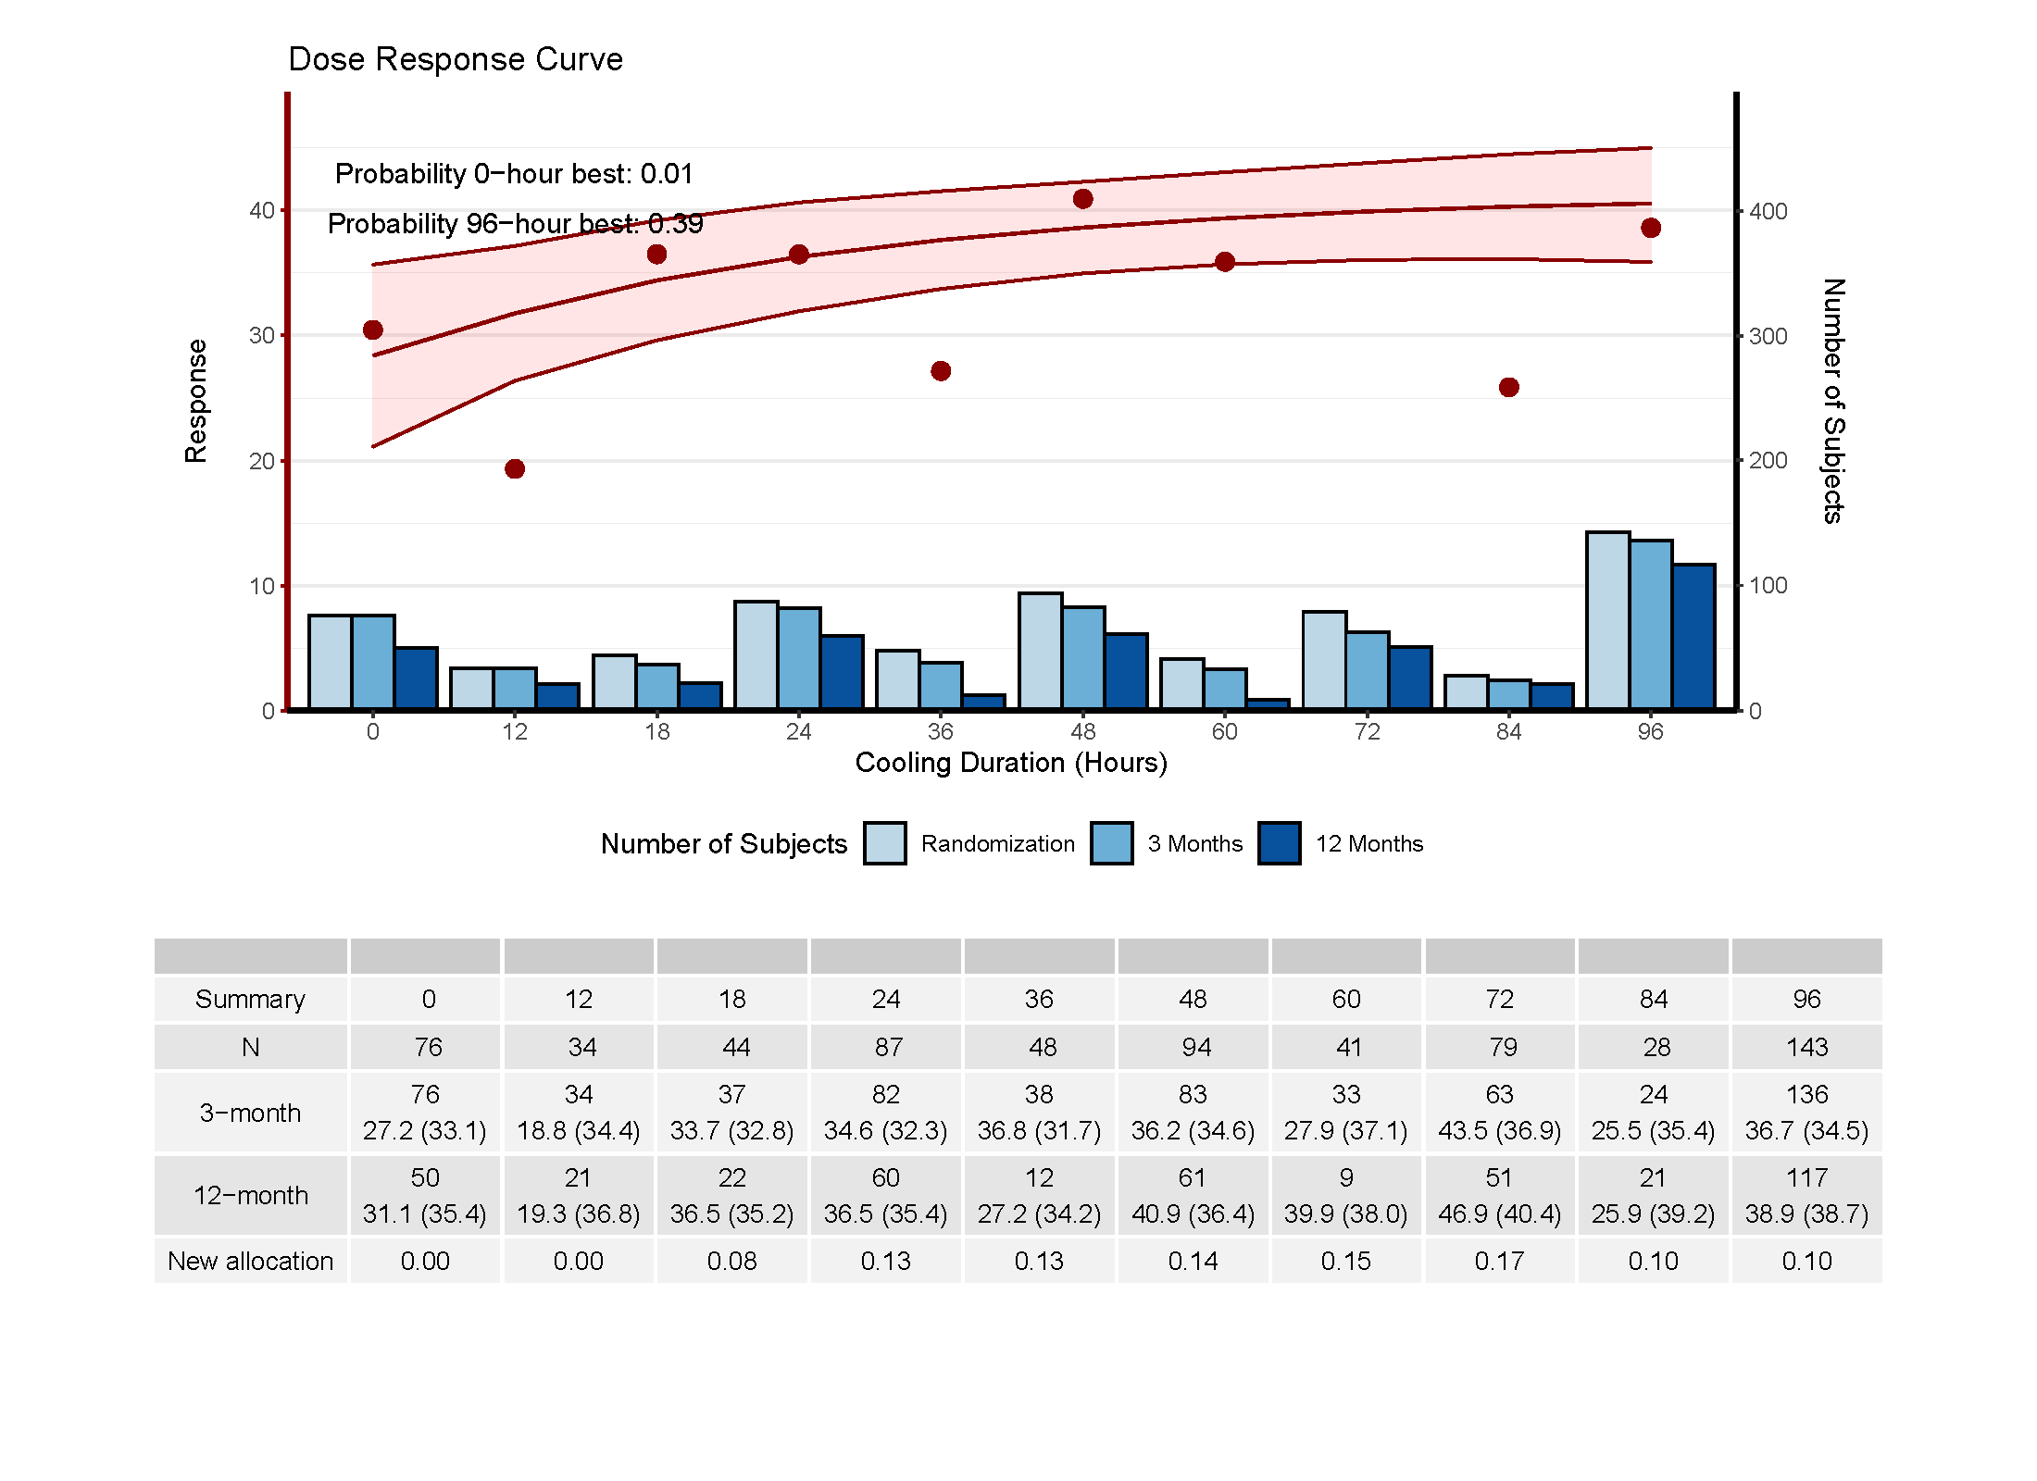

Slide 18
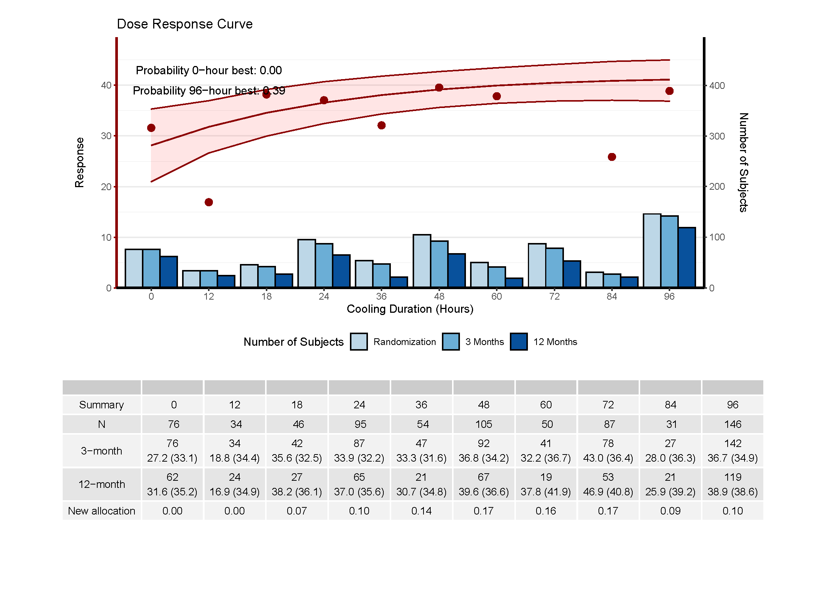

Slide 20
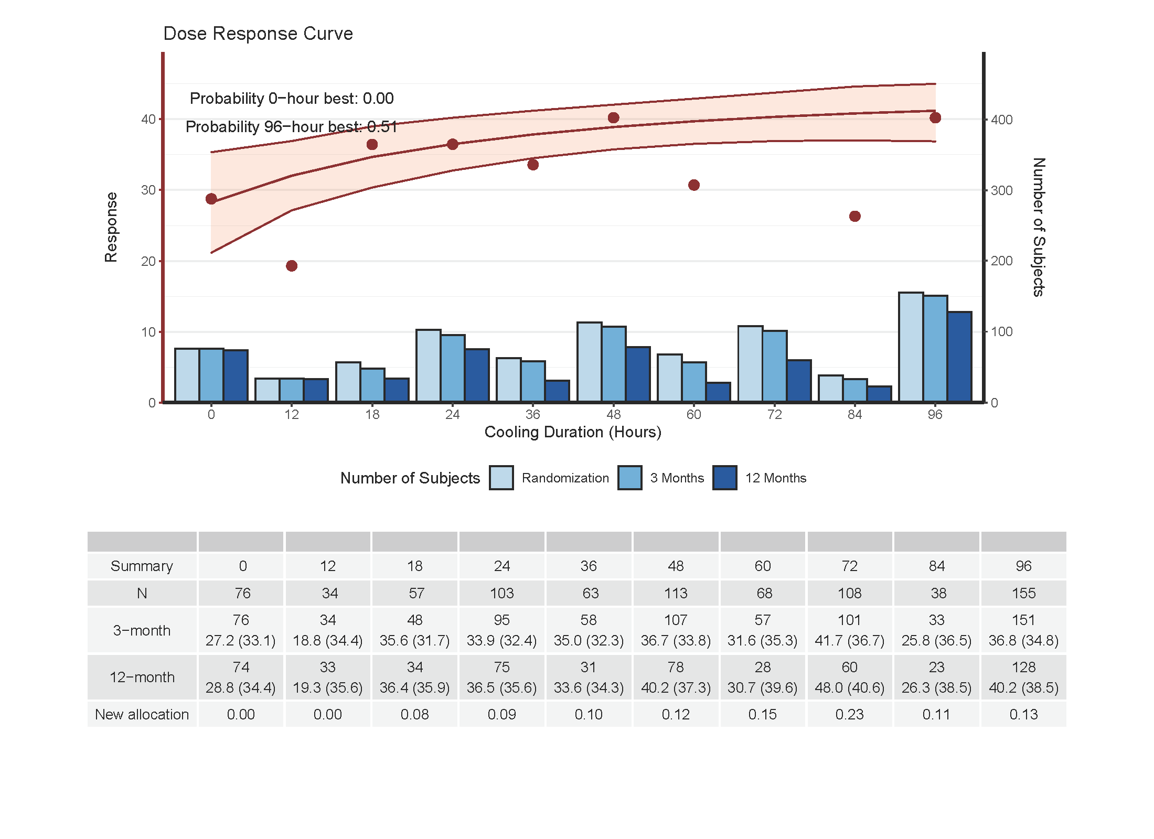

Slide 21
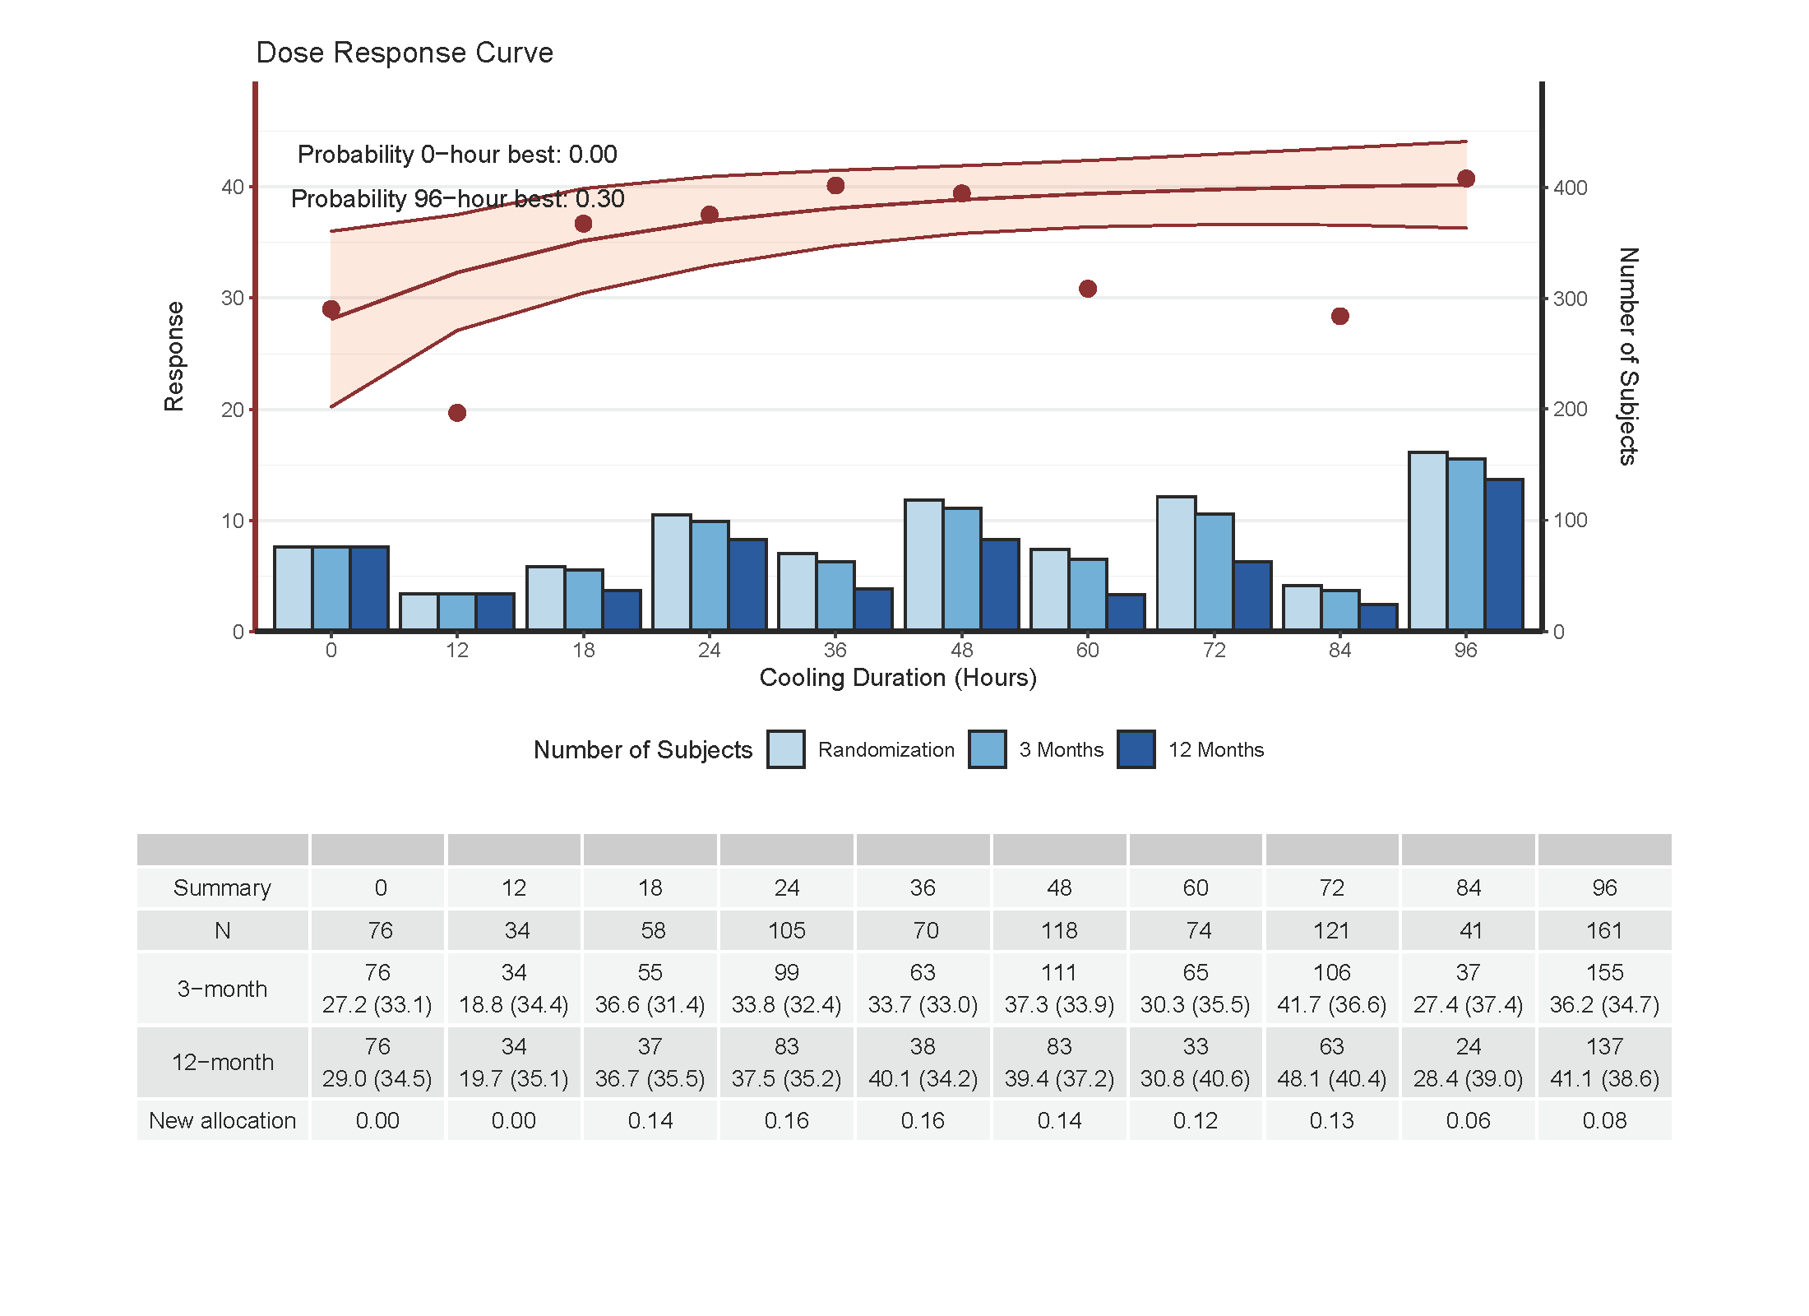

Slide 22
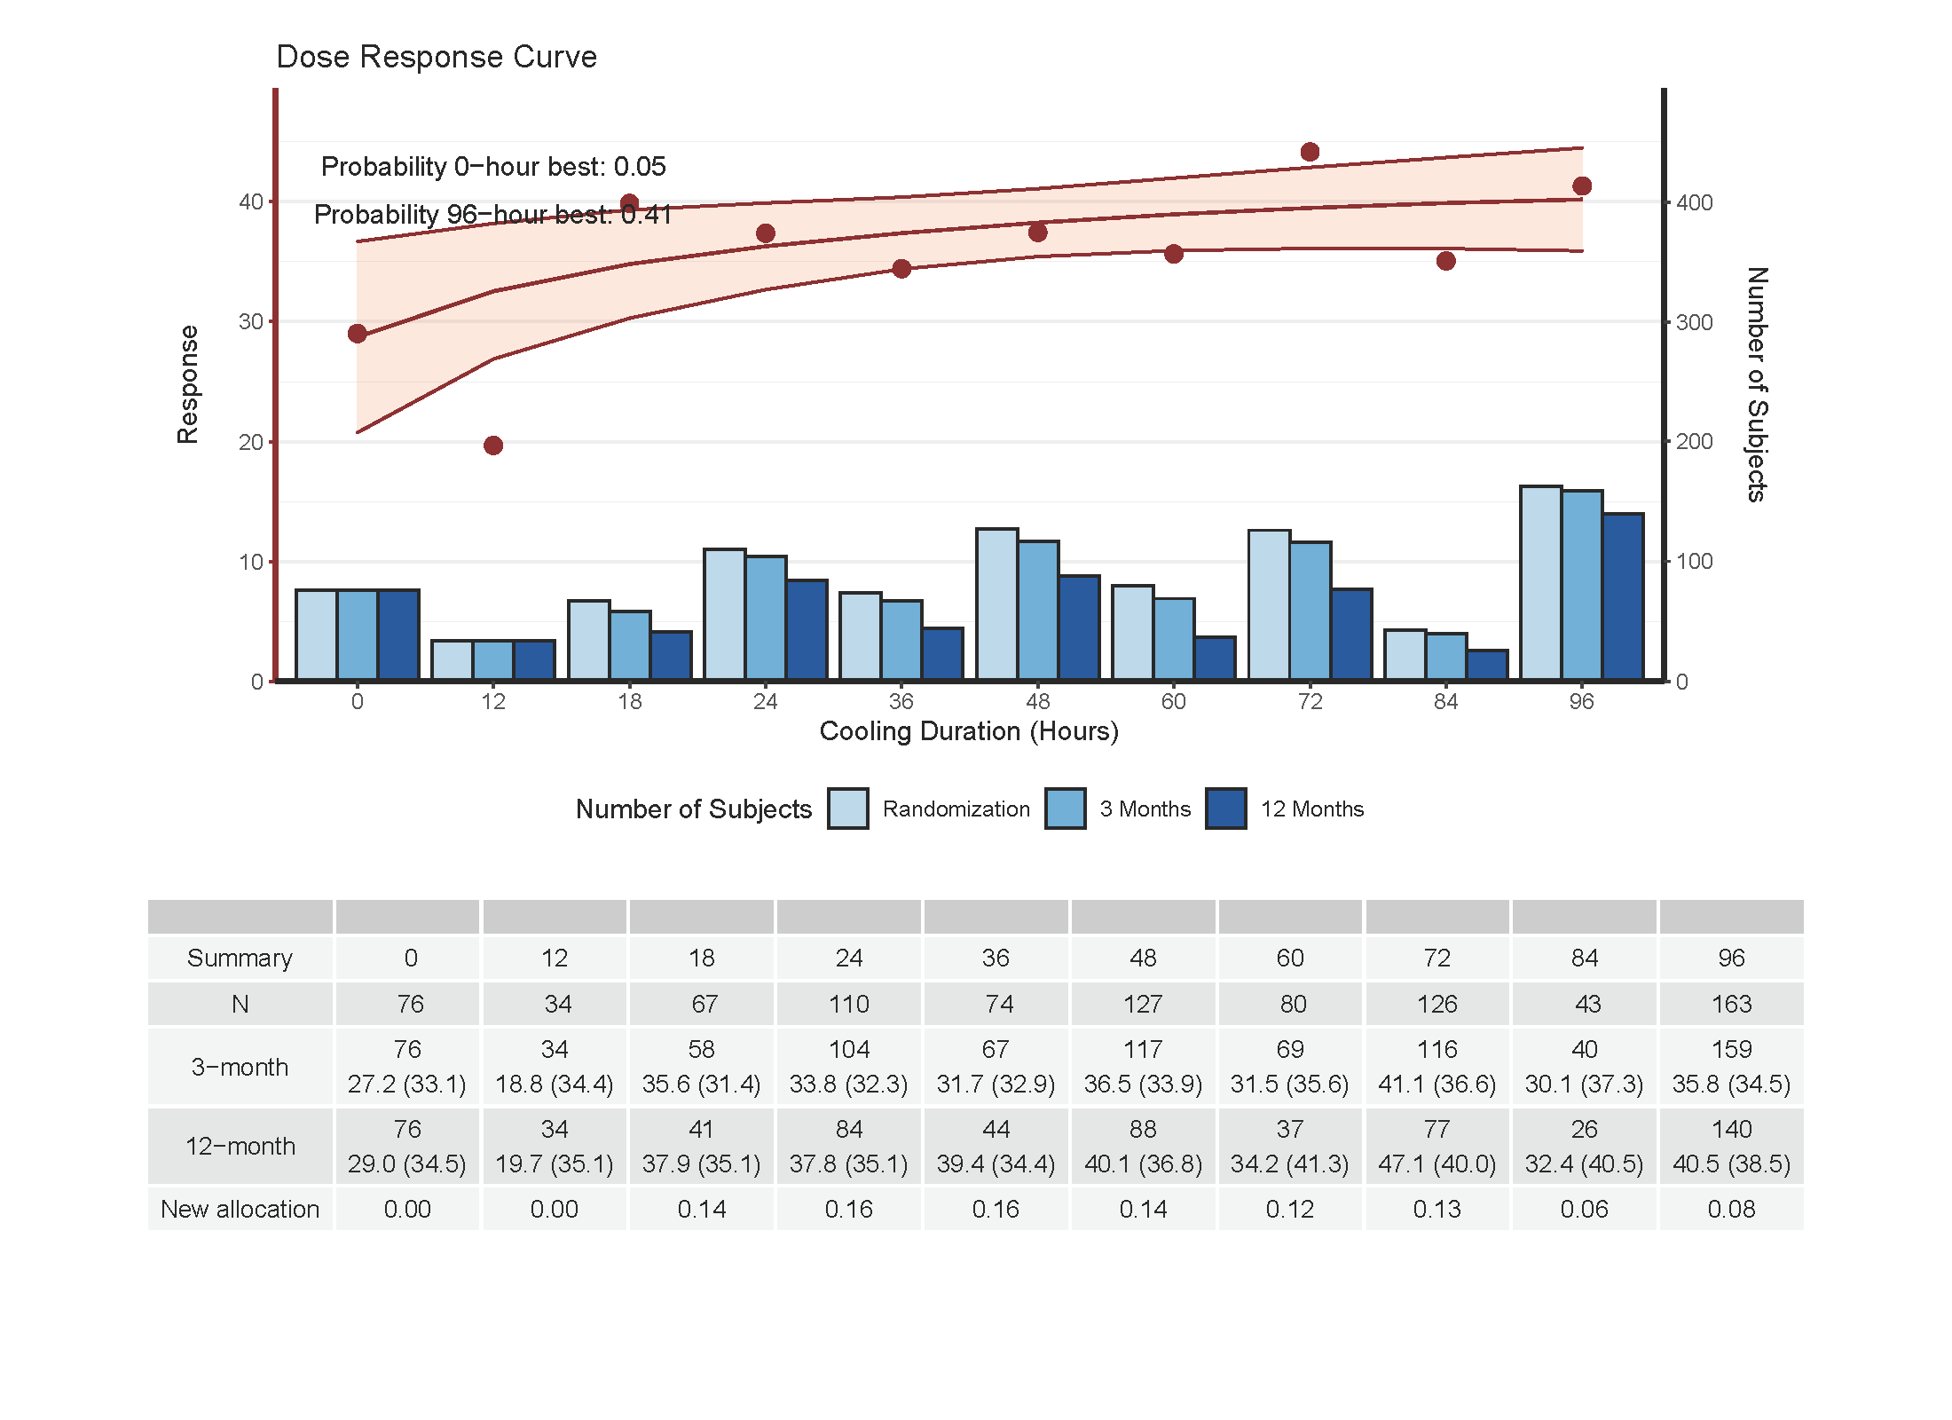

Slide 23
Example Trial 2

Slide 25
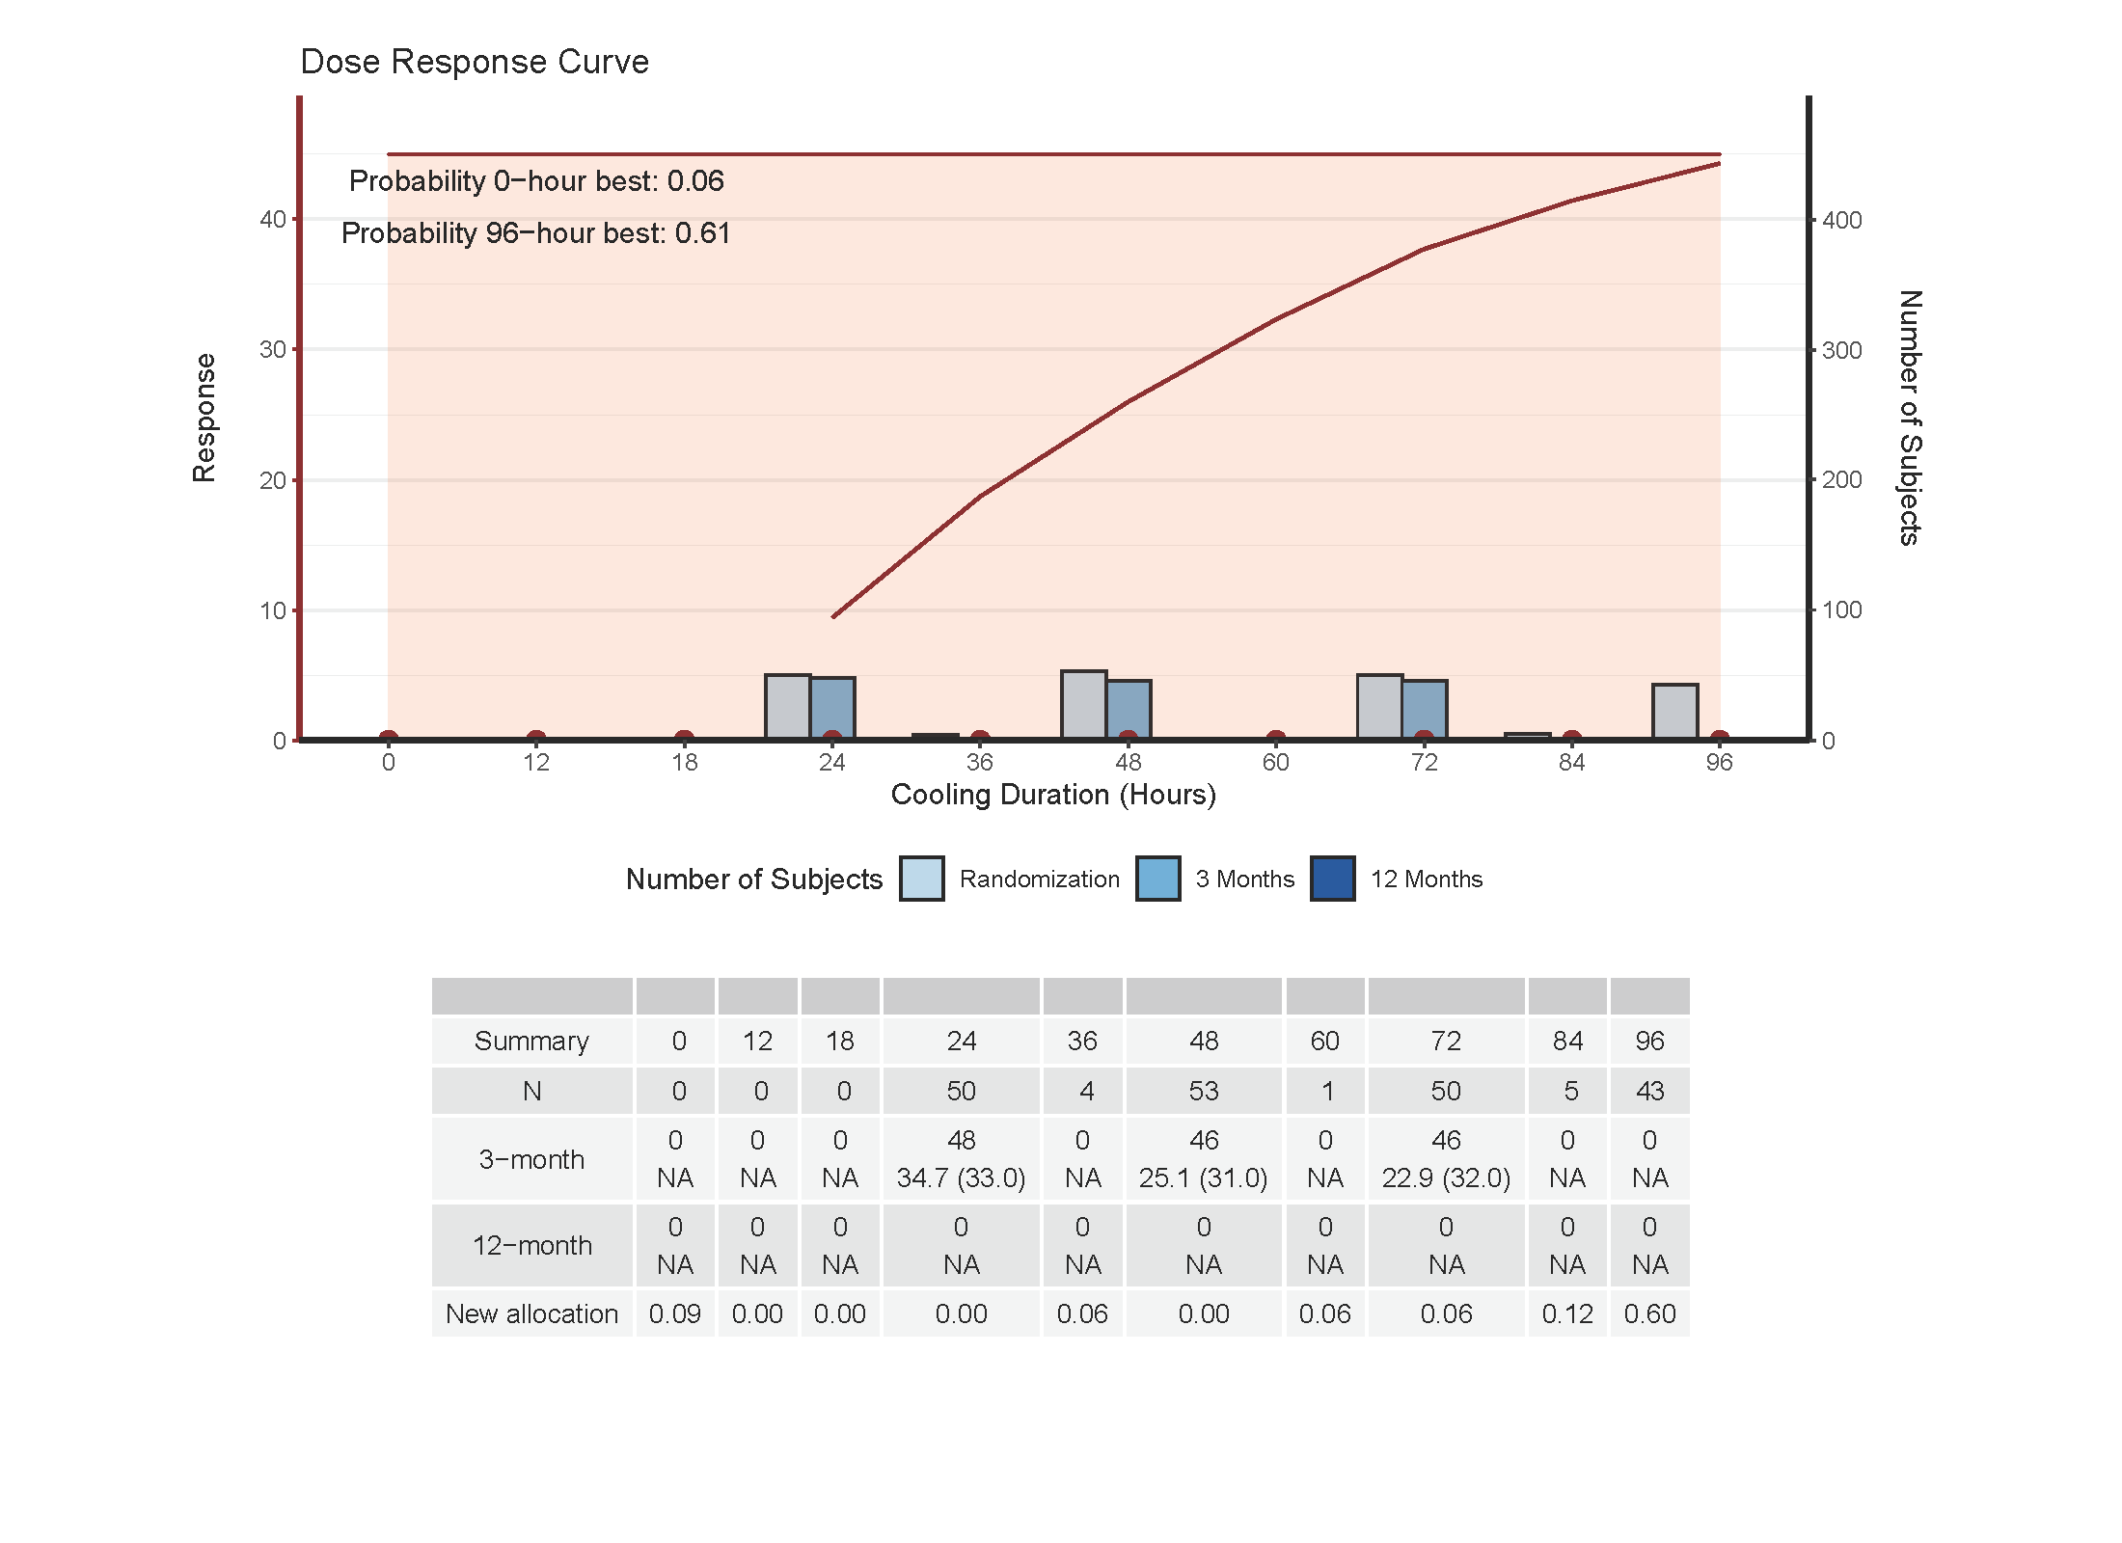

Slide 26
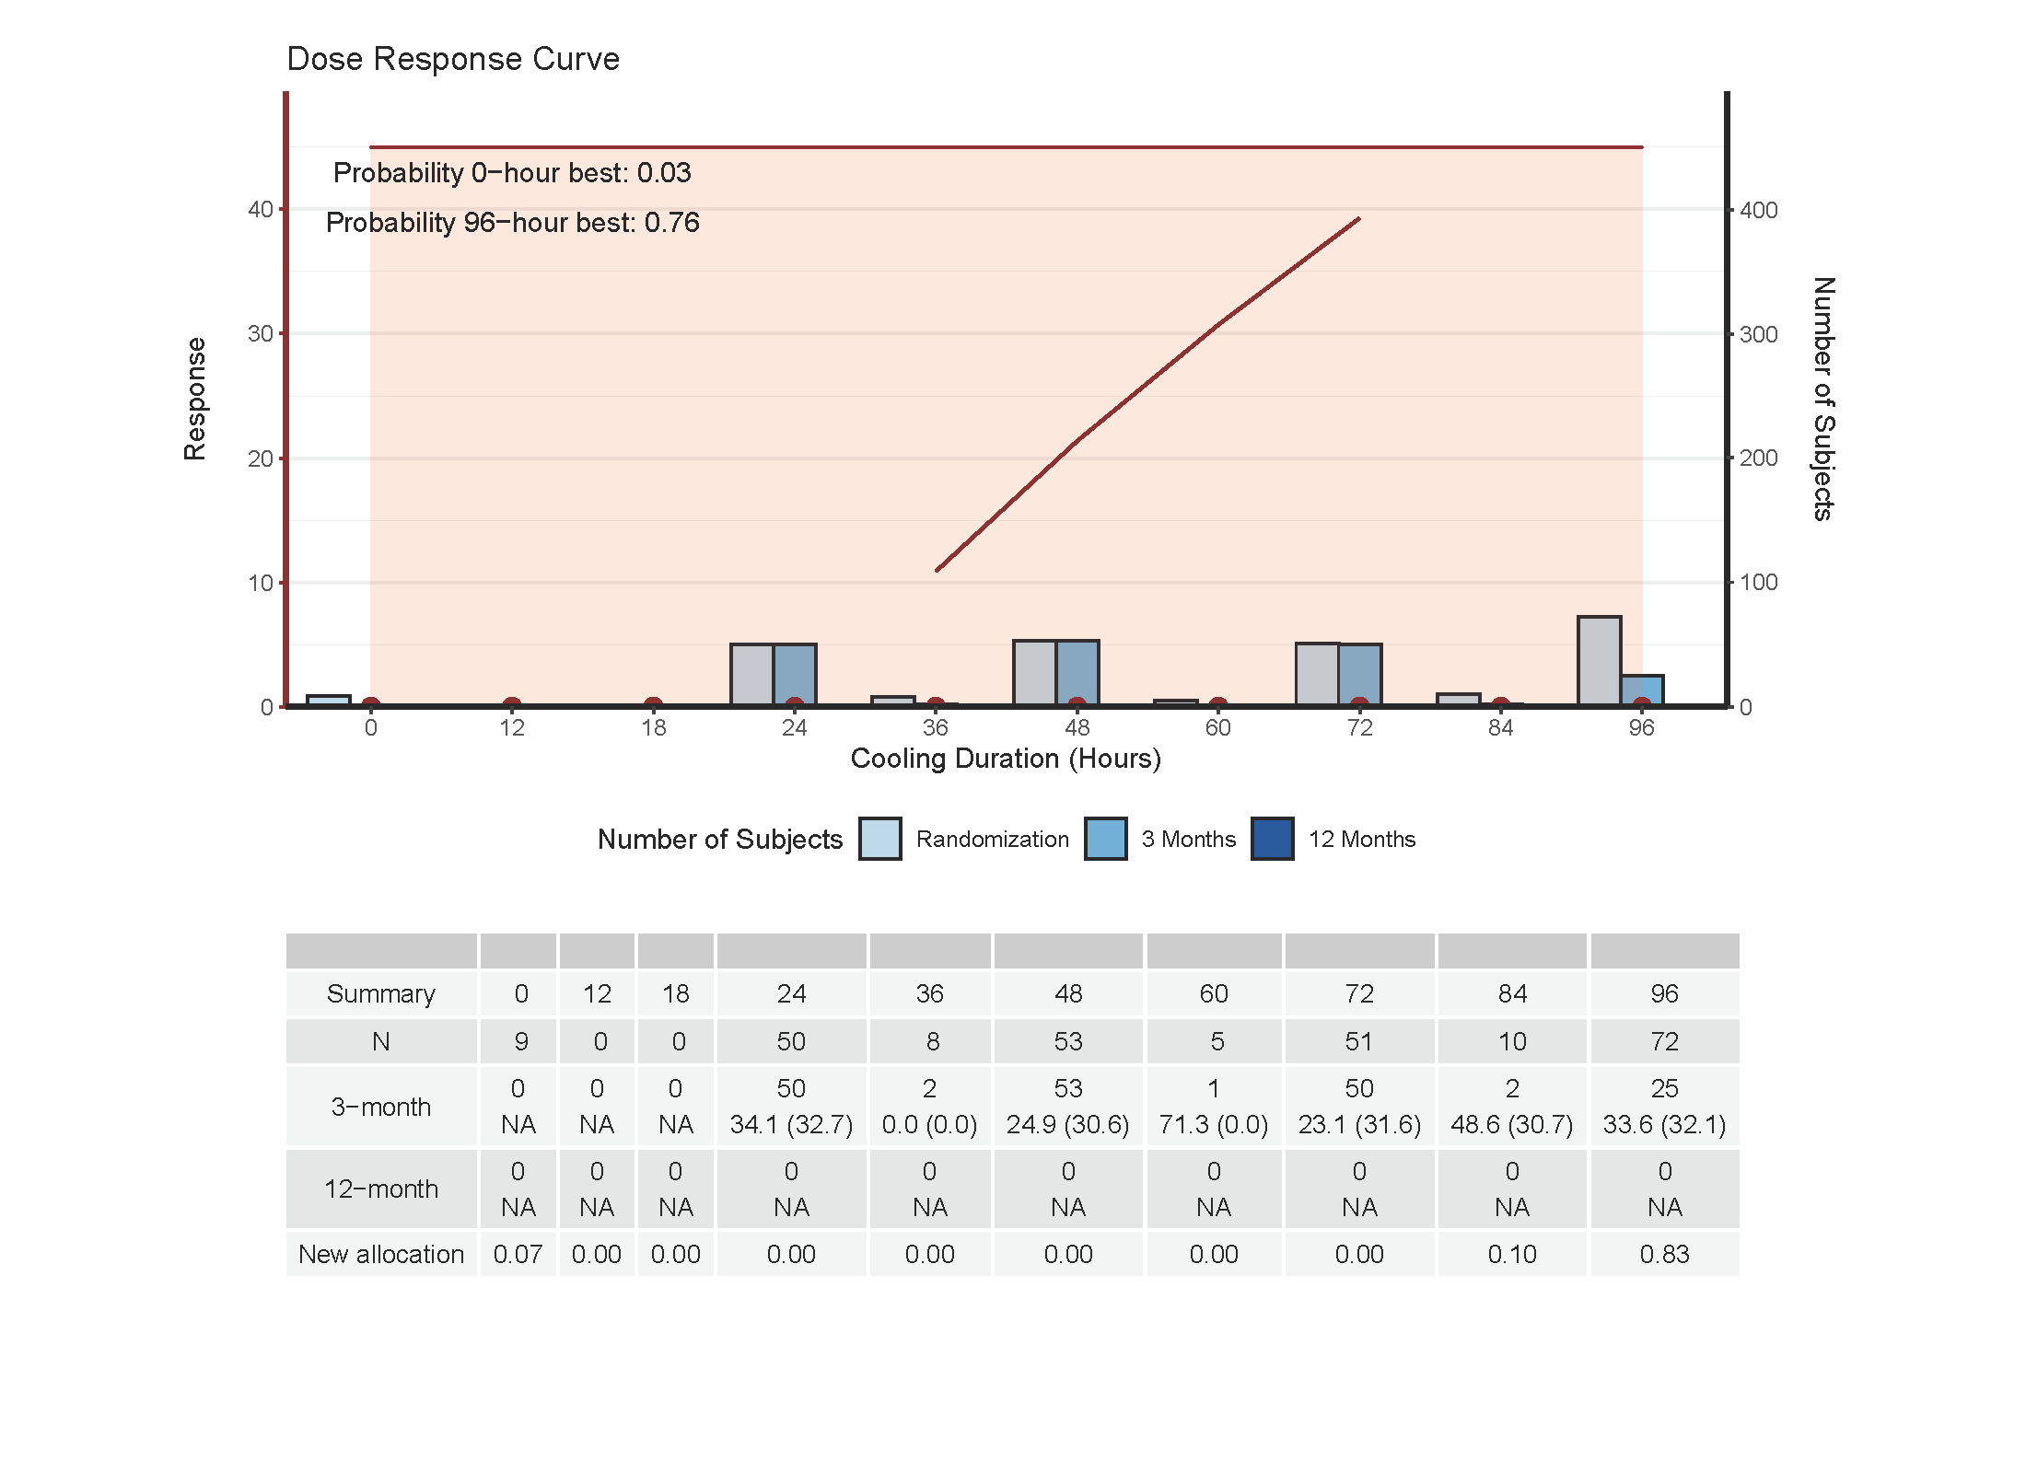

Slide 27
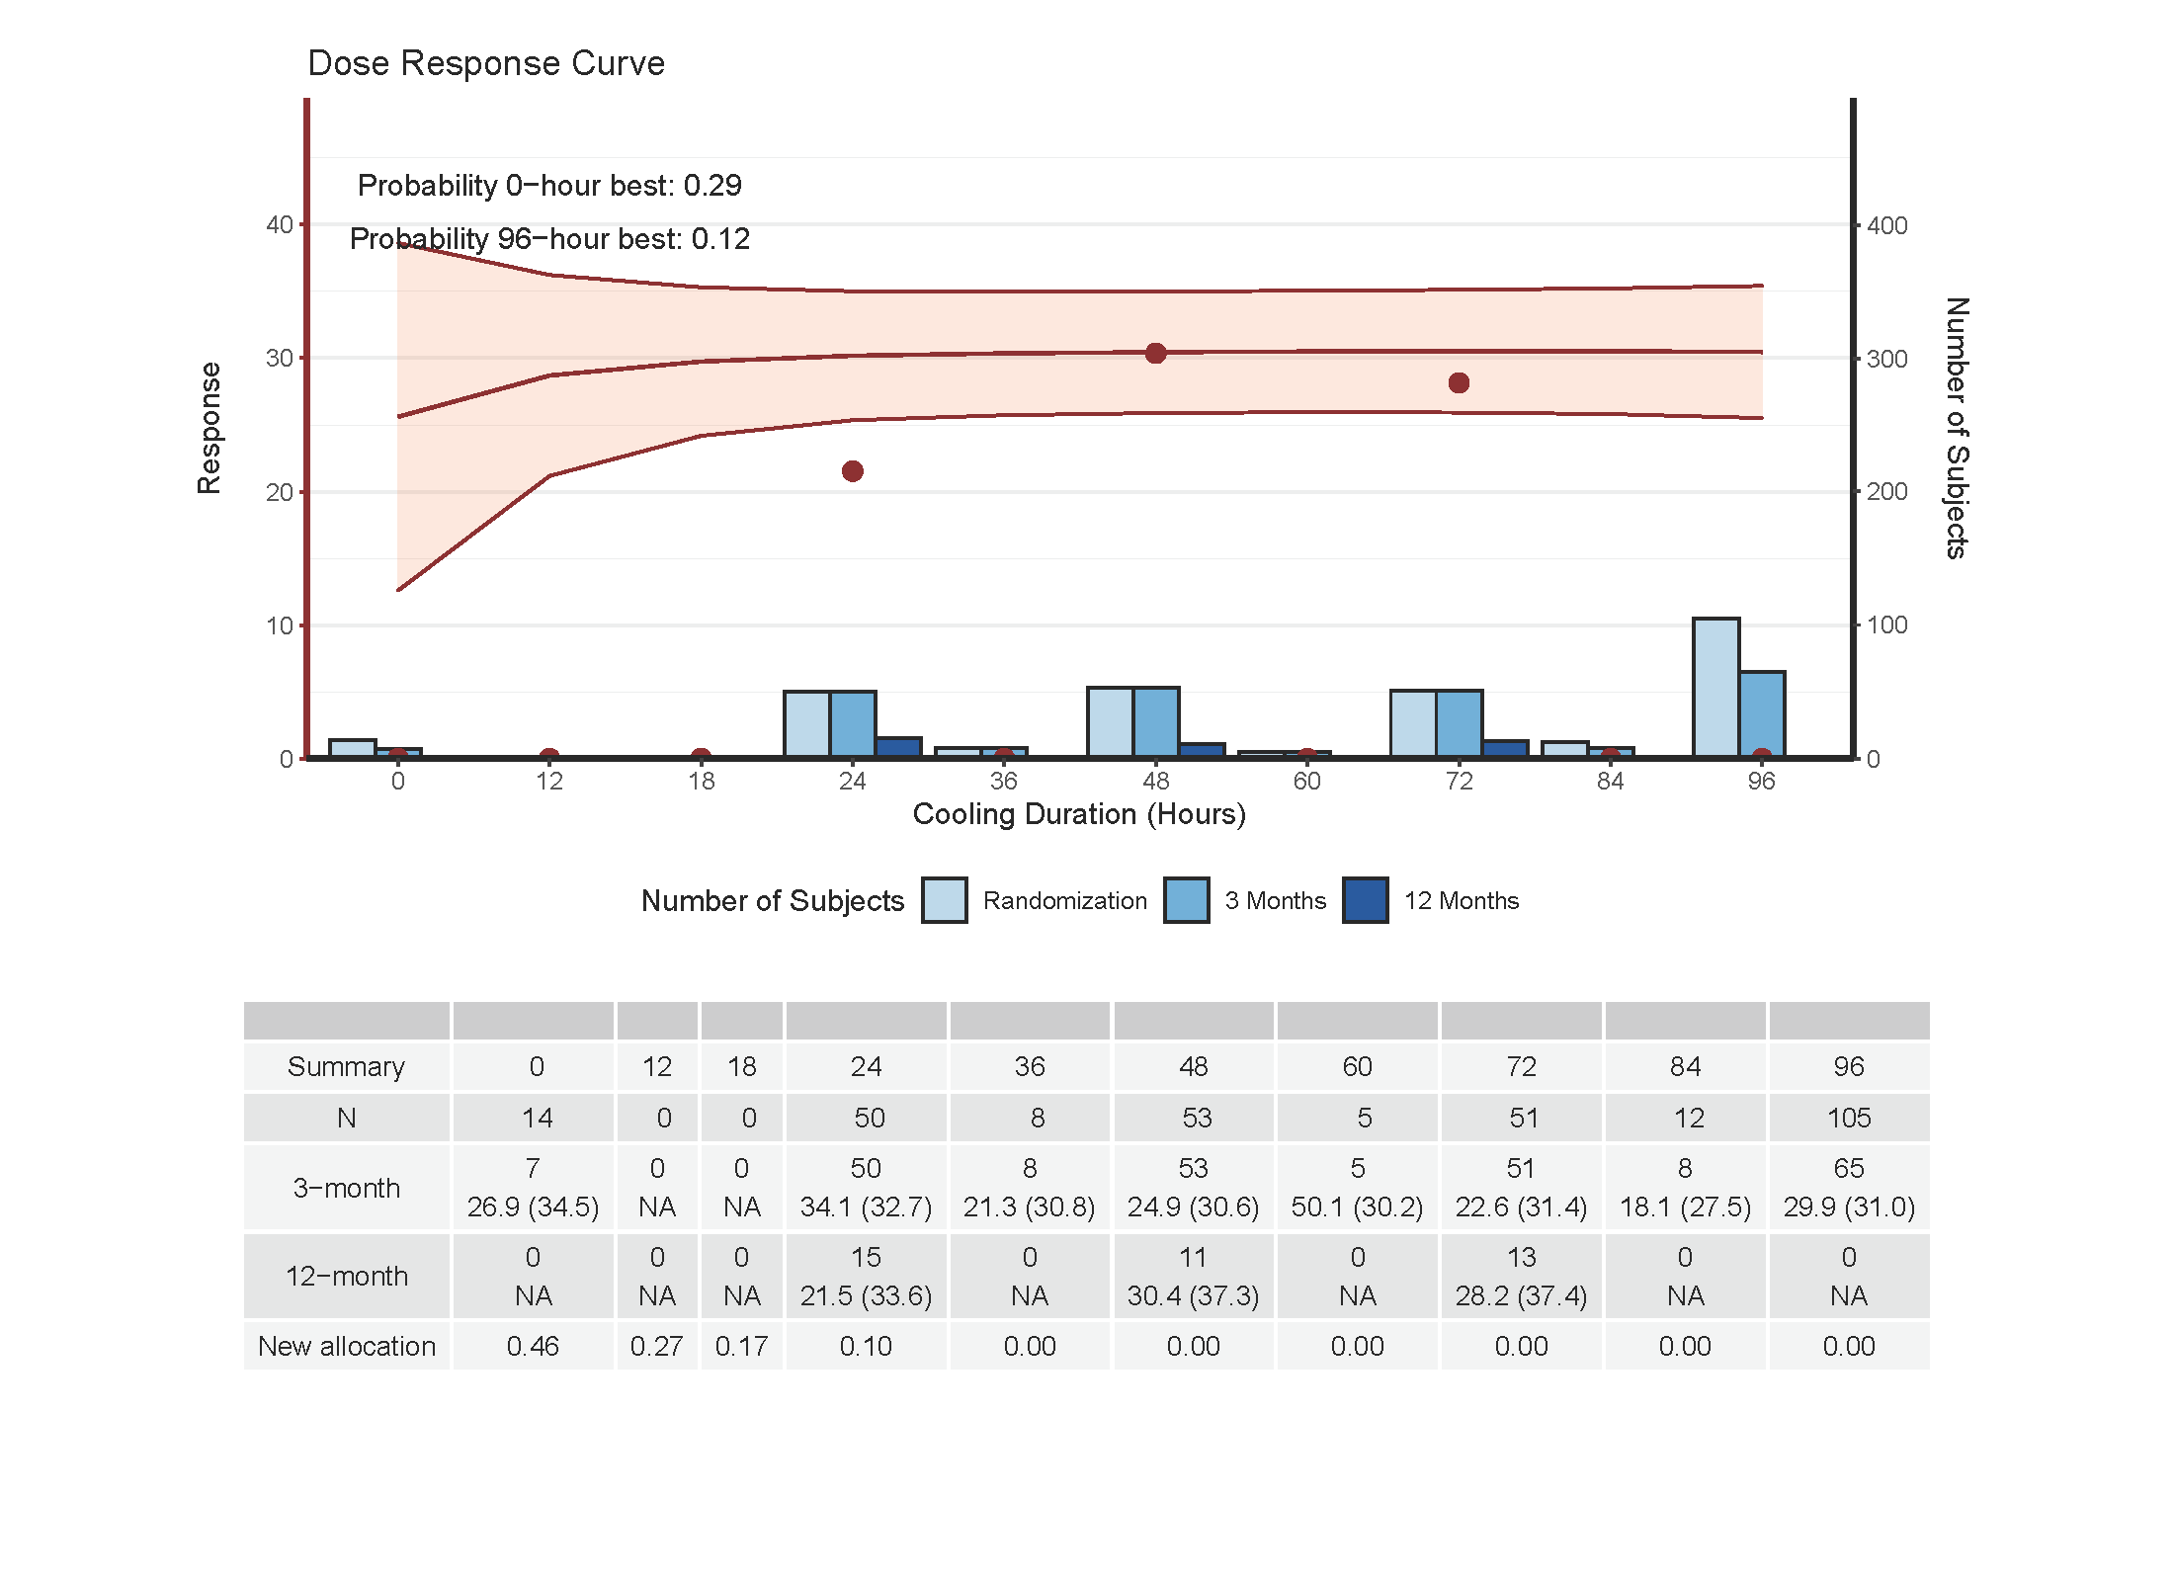

Slide 28
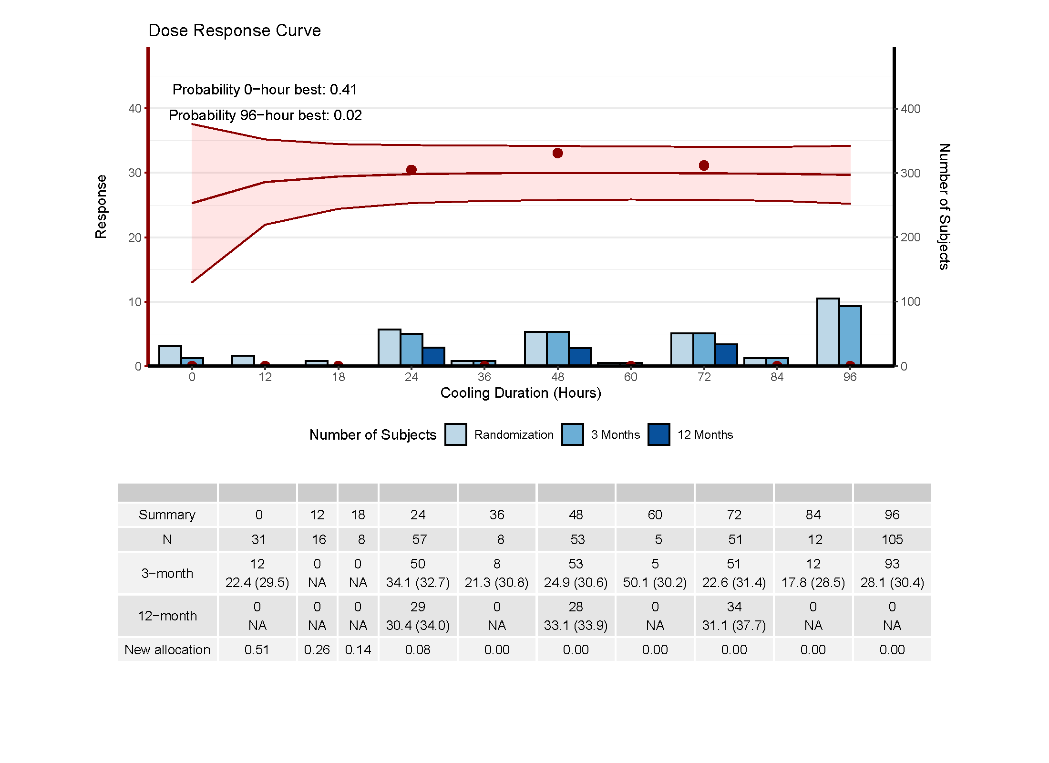

Slide 29
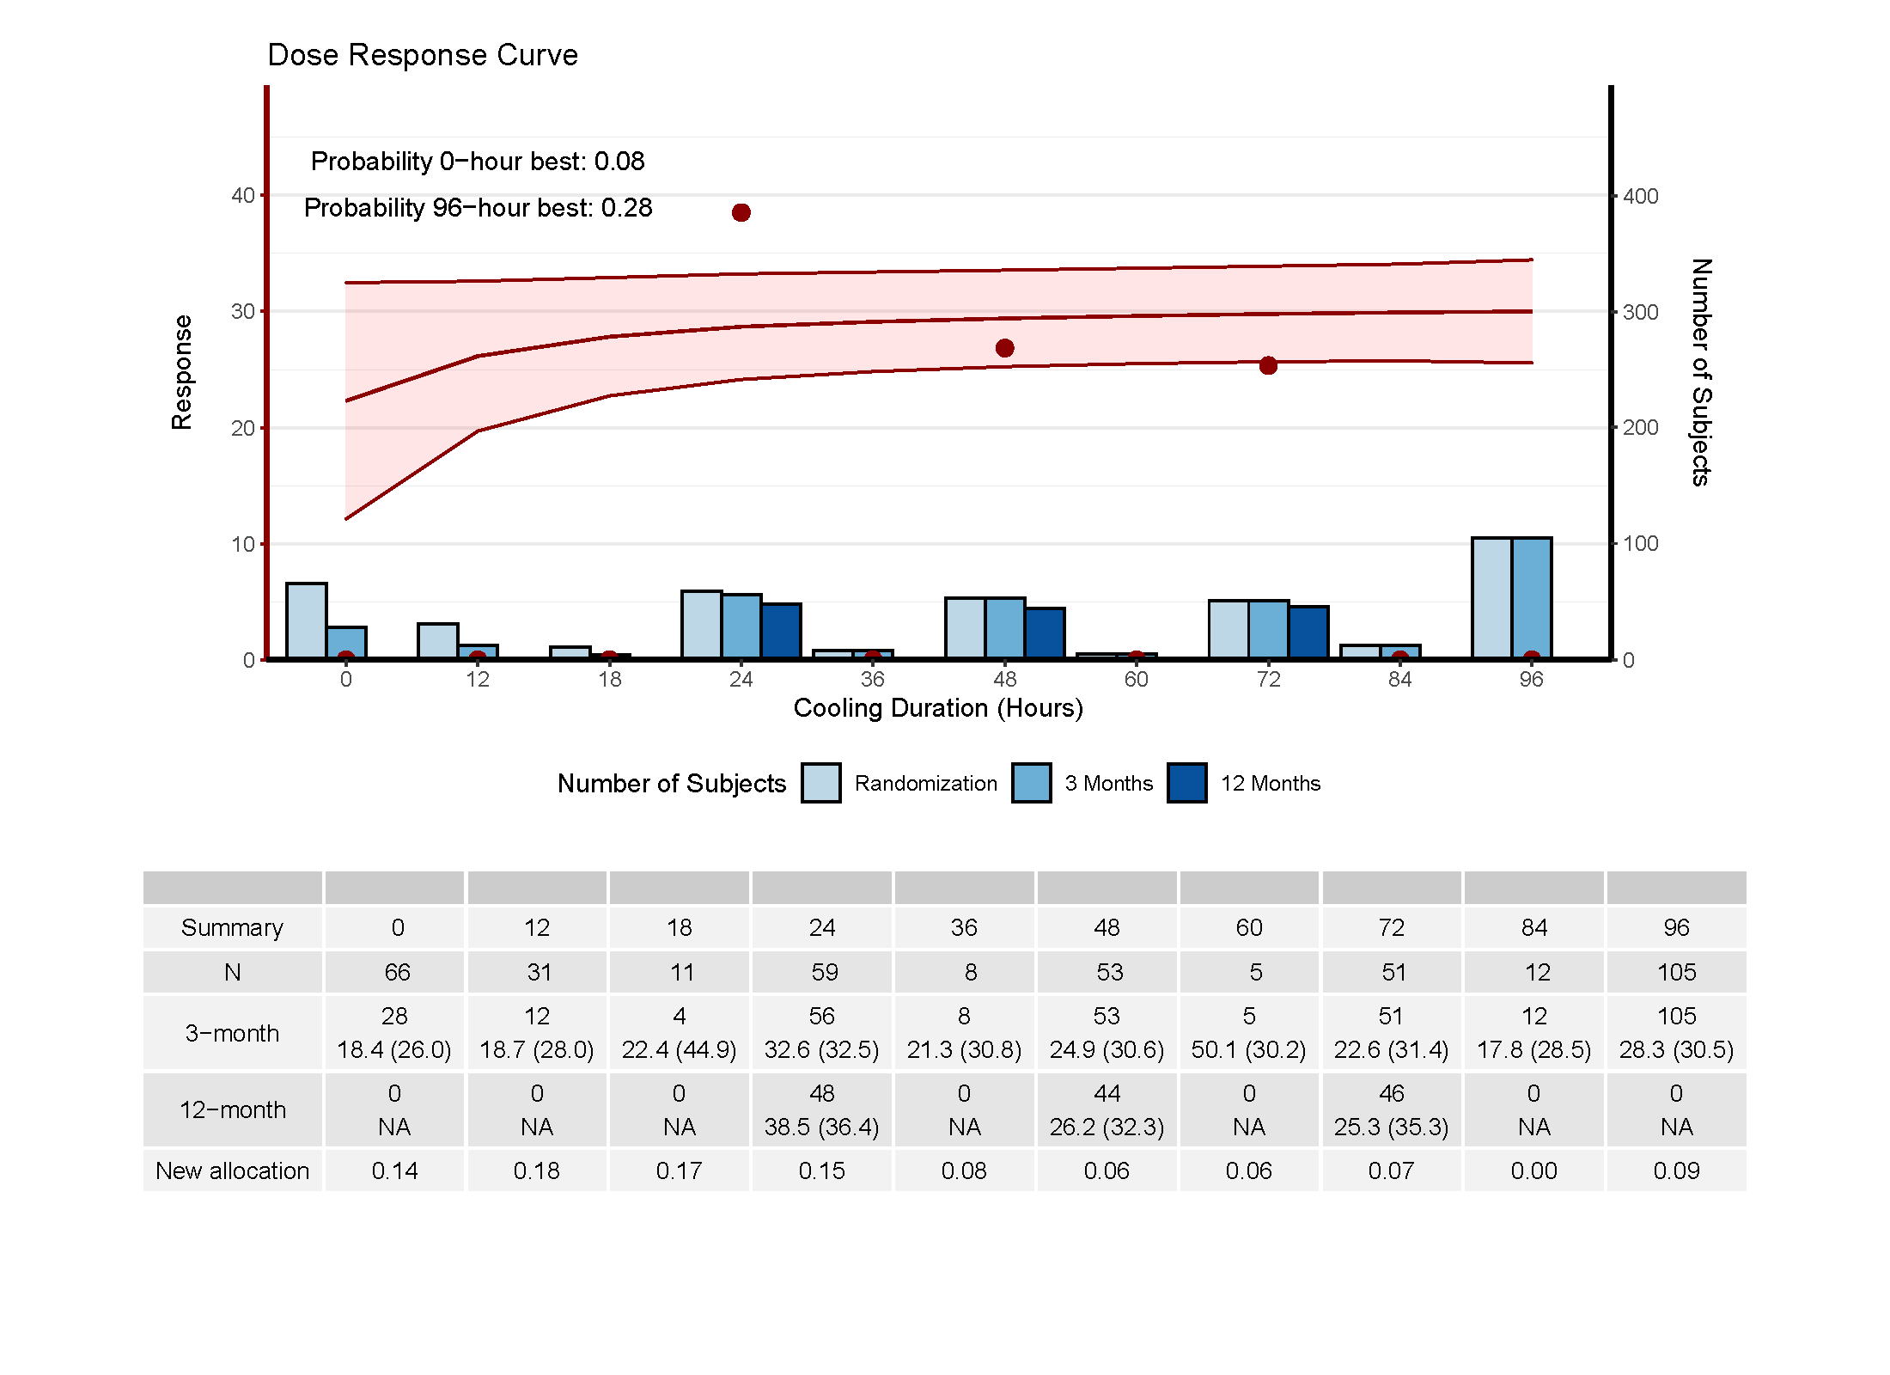

Slide 30
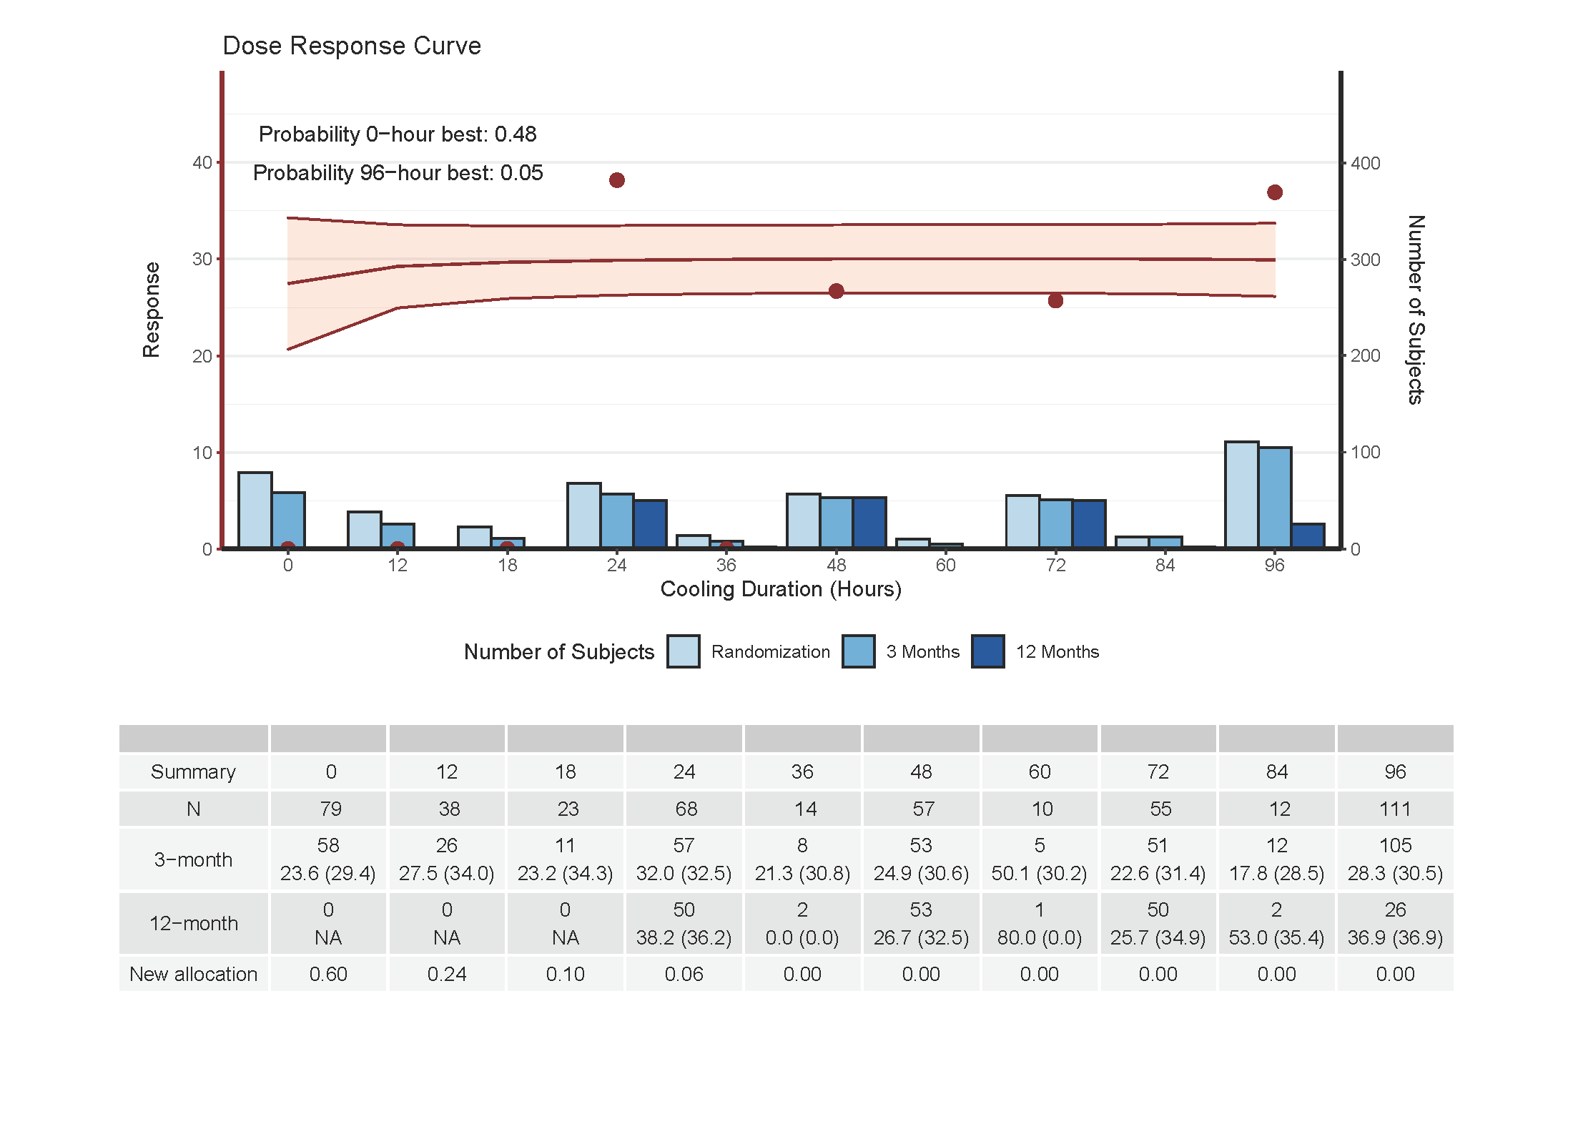

Slide 31
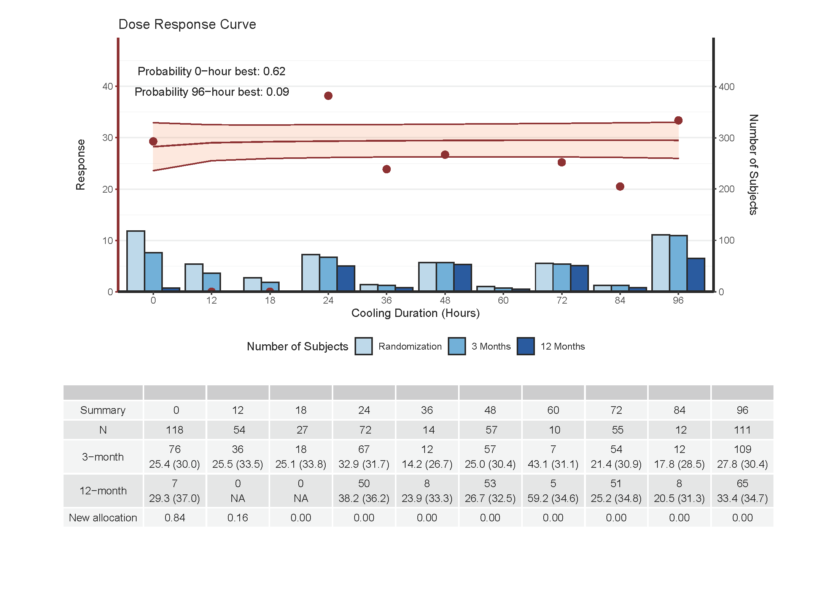

Slide 32
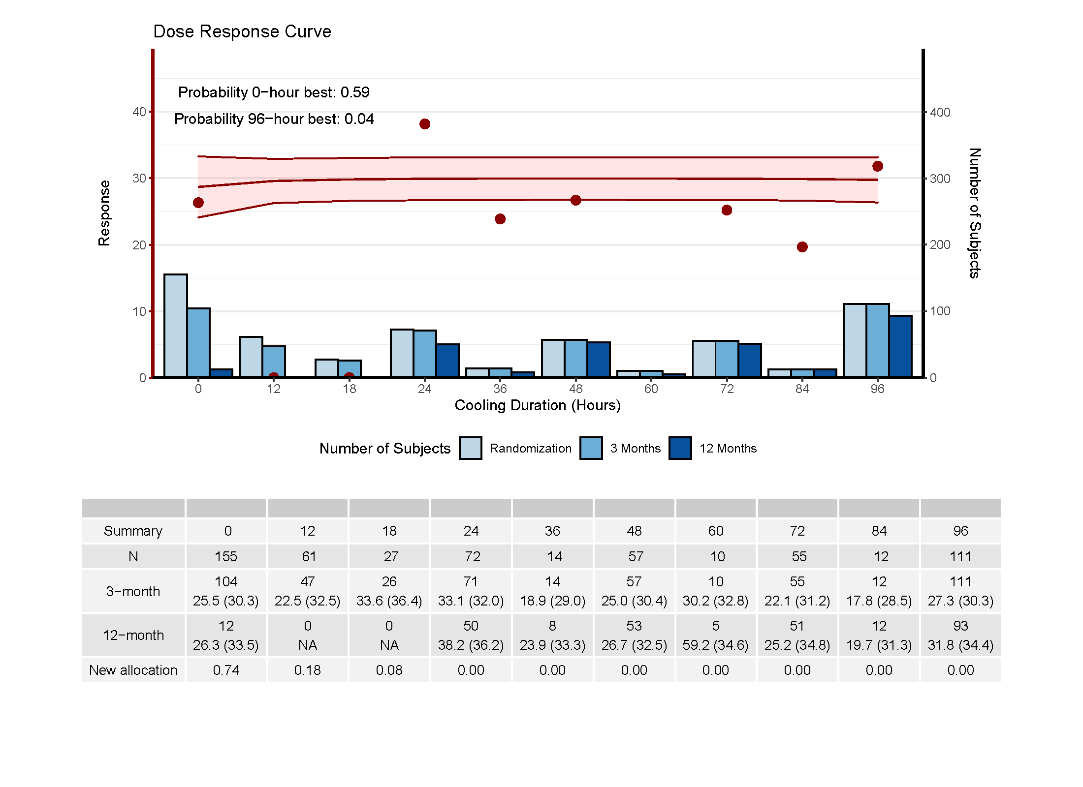

Slide 33
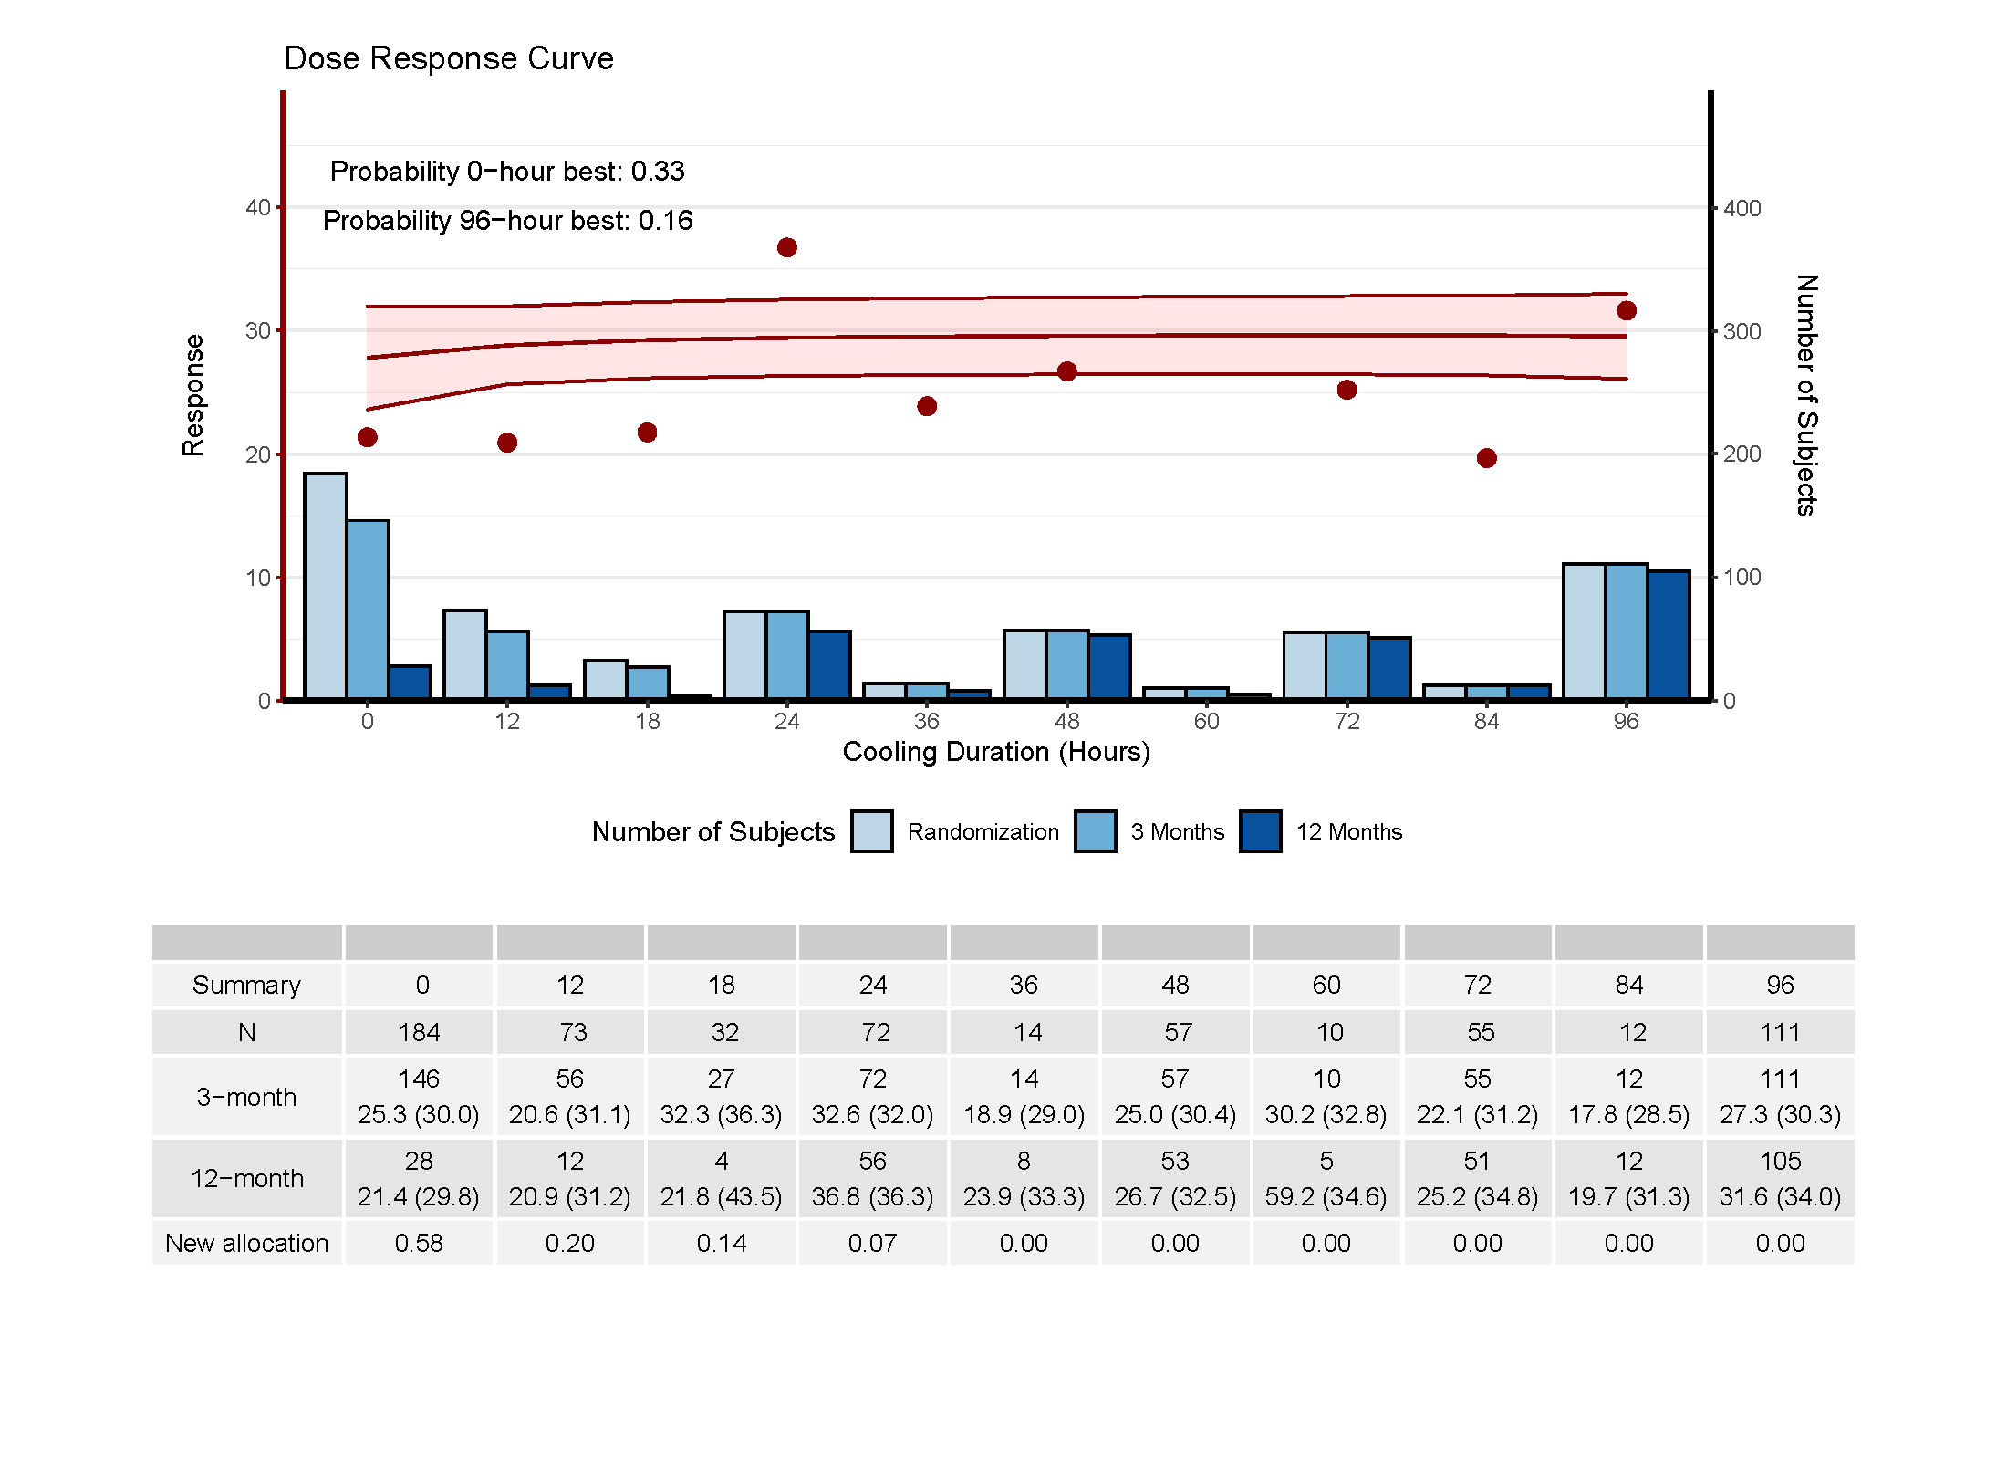

Slide 34
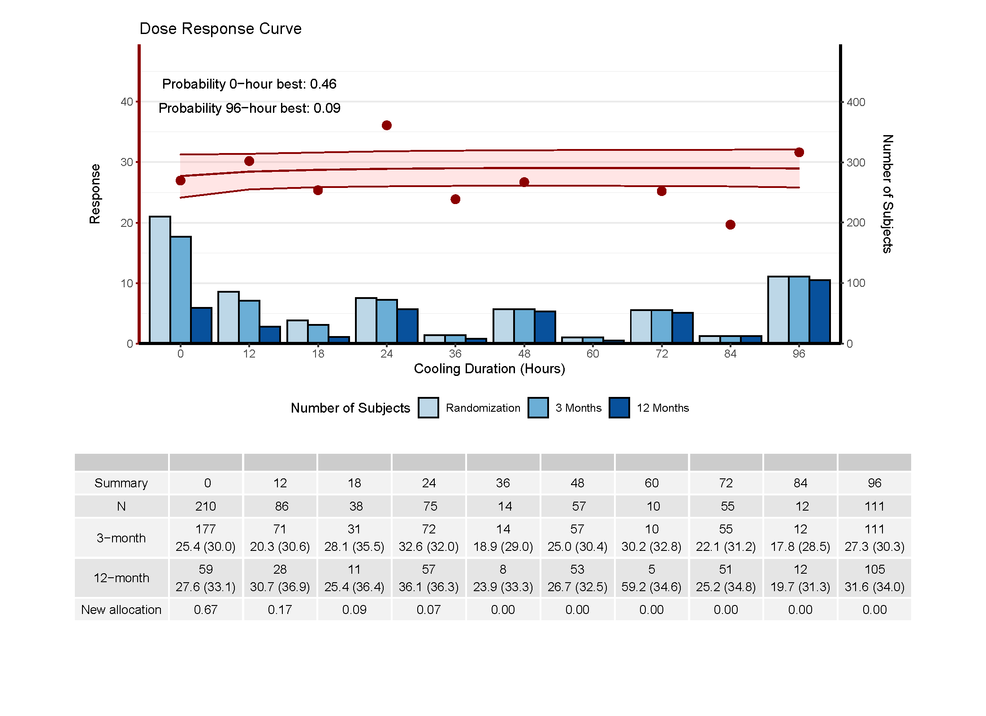

Slide 35
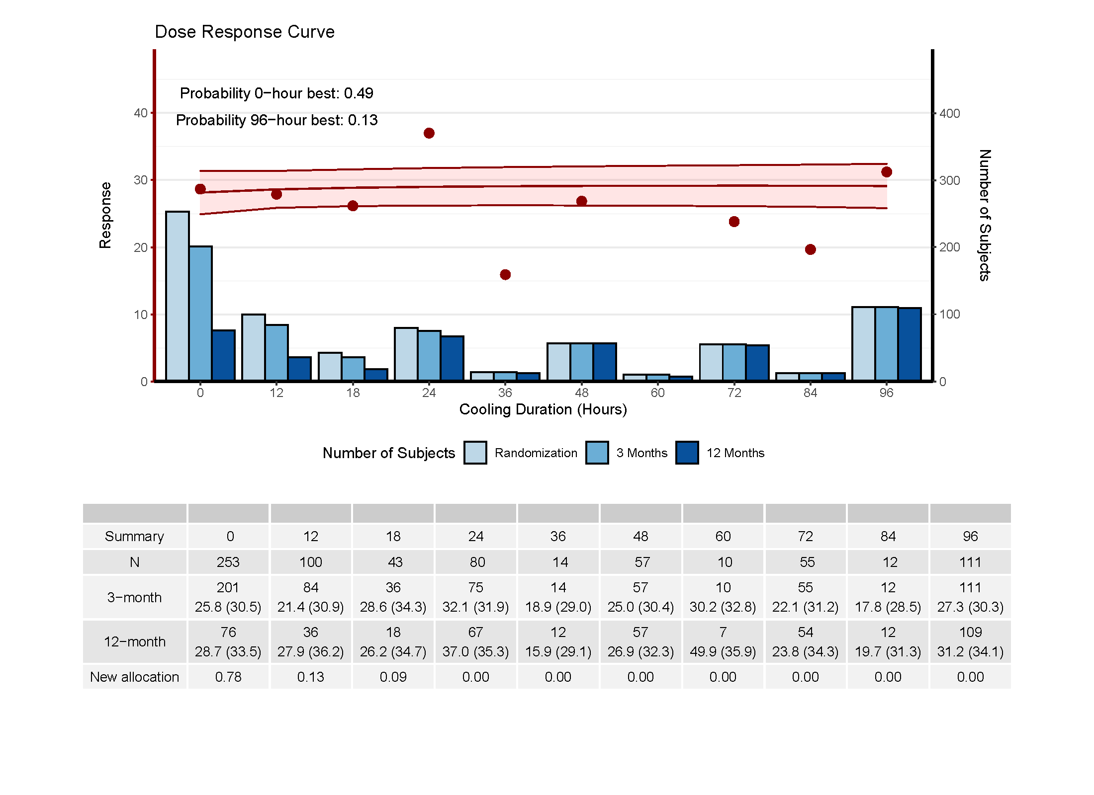

Slide 36
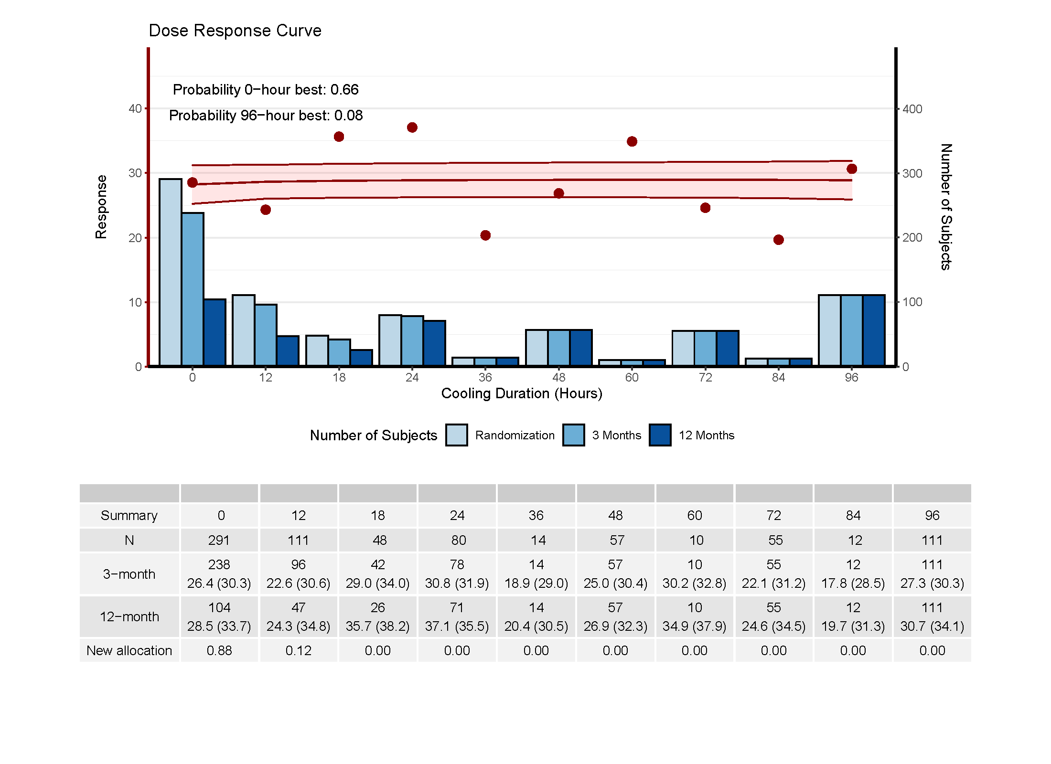

Slide 37
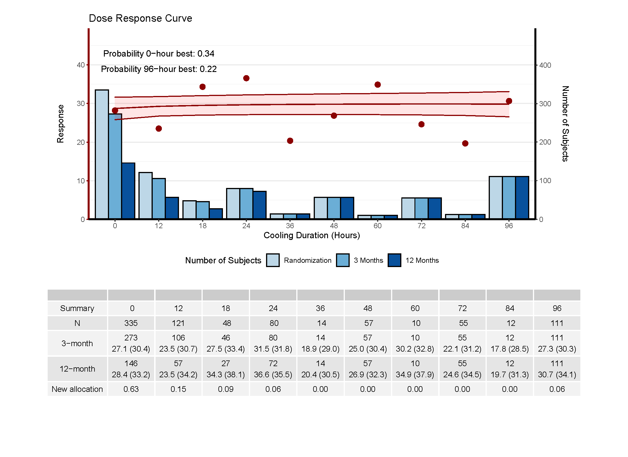

Slide 38
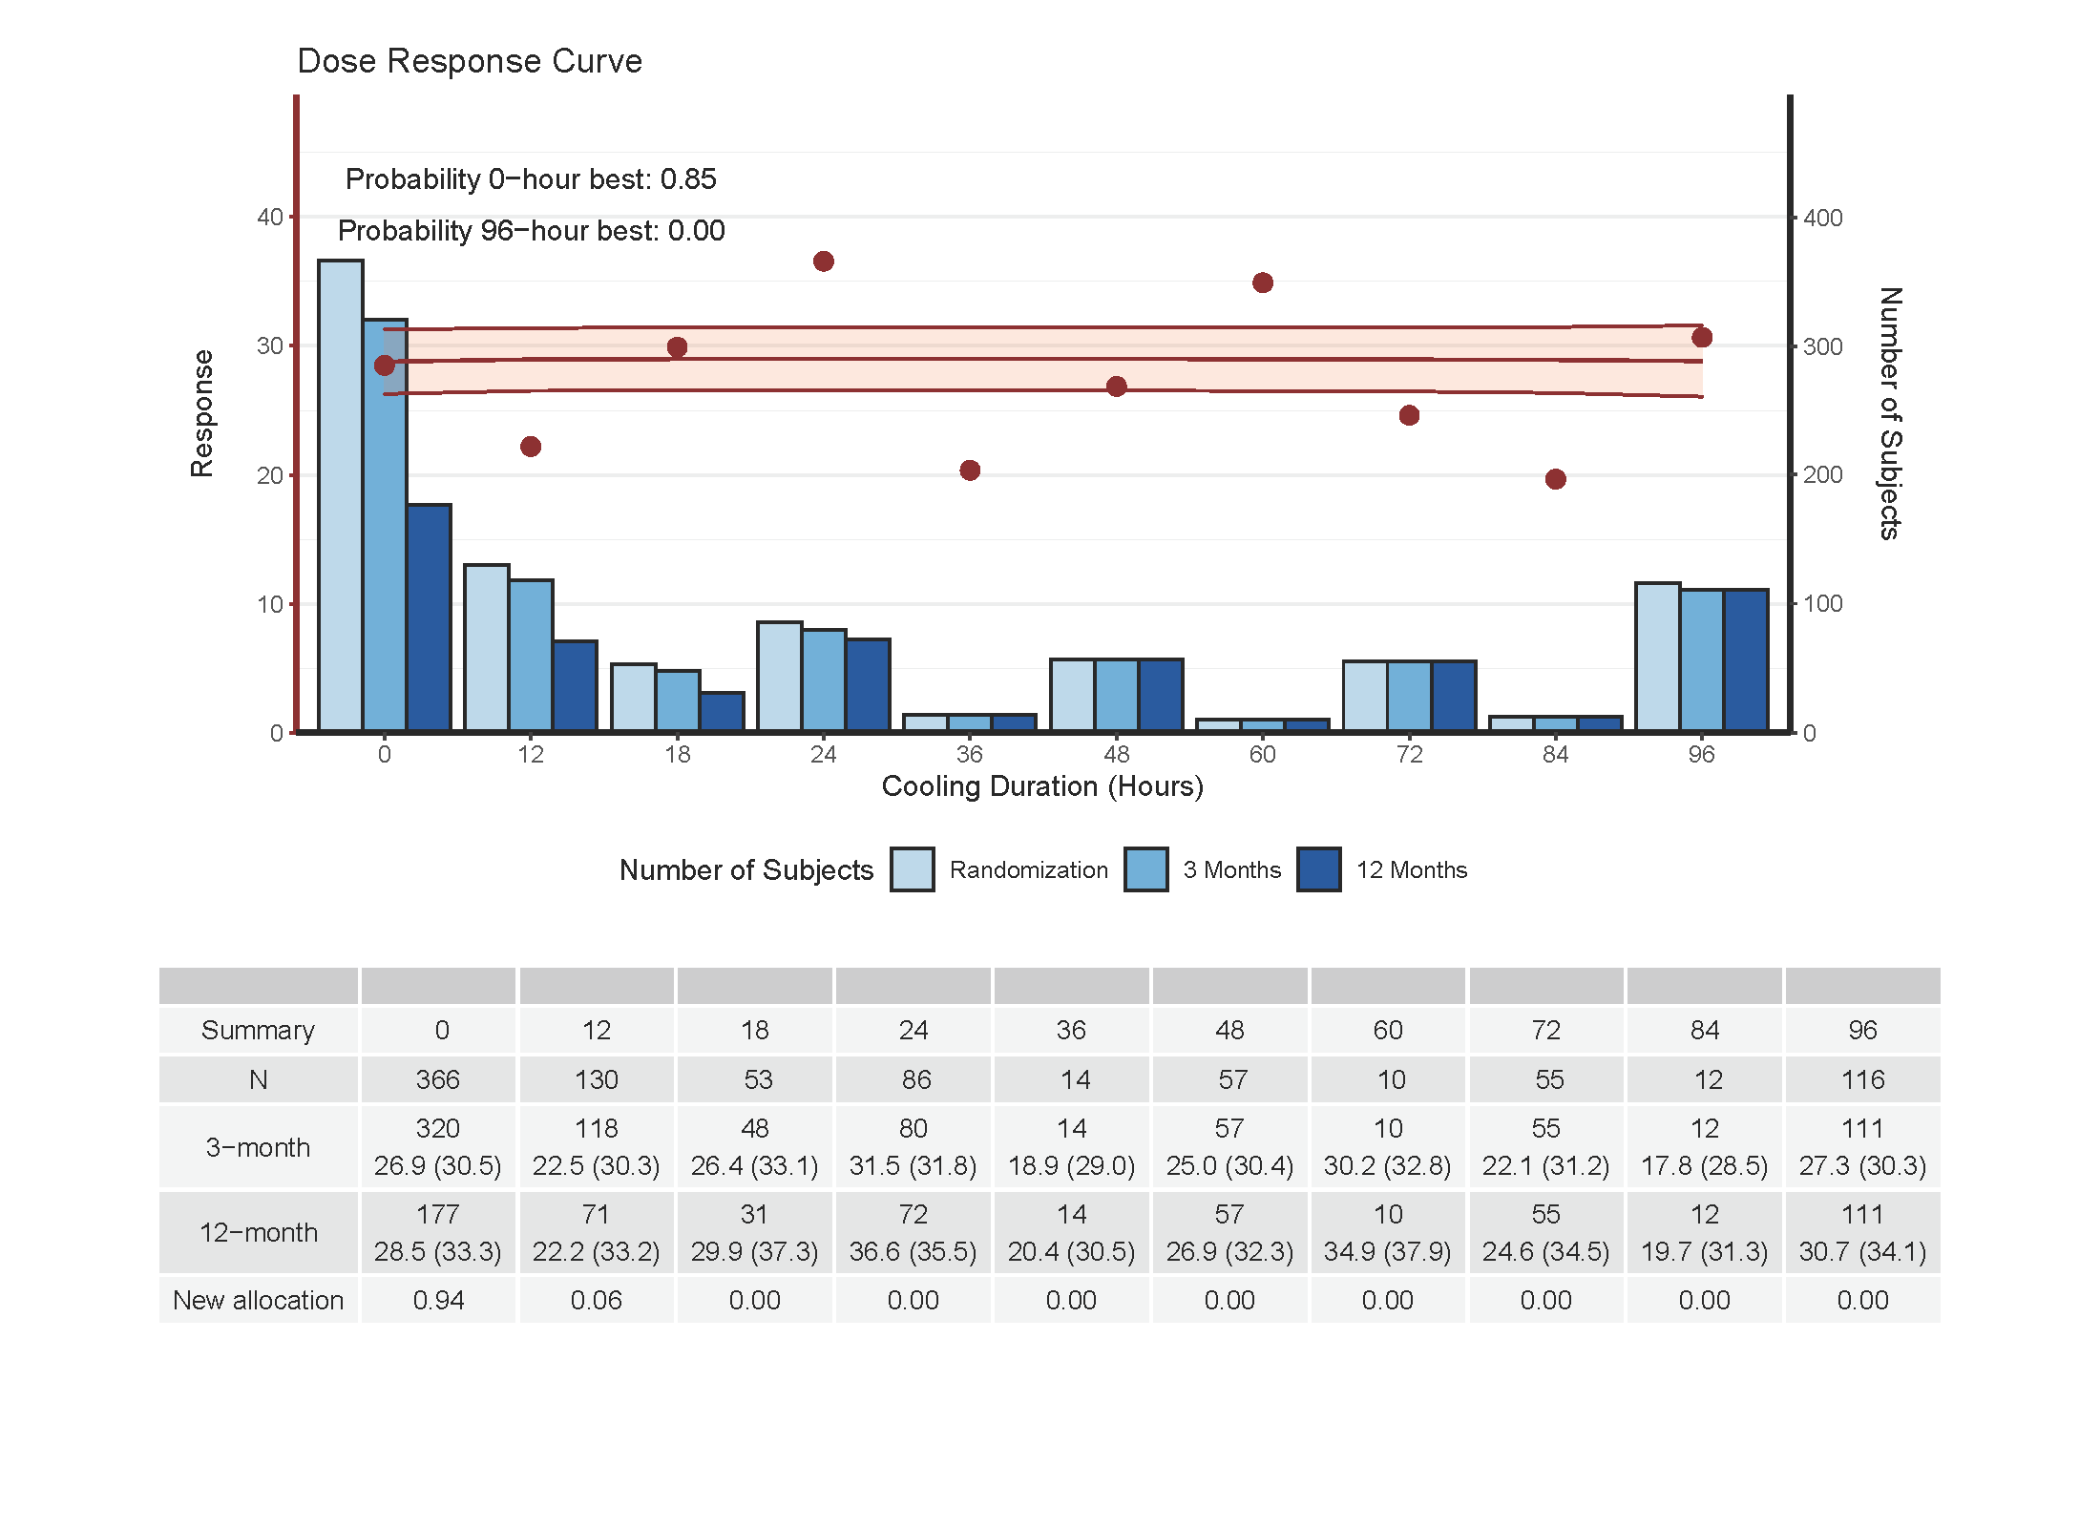

Slide 40
Summary
The adaptations will be updated every 10 weeks based on the dose response curve
At the end of the trial, we will identify optimal cooling durations based on the dose response curve
Sites will be knowledgeable of individual patient arms, but blinded to overall randomization allocations

Slide 41
Thank you!

